Slide 2
Workforce Strategy and Planning Update
How to set your image in the placeholder
Right click image and select “format picture”
Select “Picture” tab
Select Crop from the drop down menu
Under Picture Position, use the Offset X and Offset Y to position your image within the frame
delete this when no longer needed
Presented by: Nicole West, Workforce Strategy and Planning
Notes:
Good Morning! I am Nicole West and I am leading the Workforce Strategy and Planning project.

Slide 3
Agenda:
Problem Statement
Future Direction
Goals
Process of selecting job descriptions
IT Job Classes & IT Job Descriptions Overview
Employee Mapping
Compensation Overview
Implementation
Lessons Learned

Slide 4
Problem Statement:
Old job classes that are 30+ years old
Generic job classes that are not specialized towards IT functions
Examples:
IT Specialist (4 levels)
IT System Software Programmer (2 levels)
Inconsistent use of job classes throughout IT community
IT Community is IT Department and LOB IT)
Note: IT Department is NON-UNION
Notes:
Workforce Strategy and Planning is an initiative partnering with HR to reach our mutual goals to:
Adjust minimum qualifications for IT job classes to open up hiring opportunities
Customize recruitment efforts for IT professionals to make us an attractive employer
Clarify the IT promotional process

Slide 5
Future Direction:
Job classes that align with IT industry and job market
Job classes focus on job function, skills and abilities and minimum qualifications
Tiered levels for growth within job classes and movement between job classes
Employees are mapped based on function

Slide 6
Workforce Strategy and Planning Goals:
Partnering with HR to reach our mutual goals to:
Adjust minimum qualifications for IT job classes to open up hiring opportunities
Customize recruitment efforts for IT professionals to make us an attractive employer
Clarify the IT job class promotional process and levels
Develop IT Classes & Descriptions that are in alignment with IT industry

Slide 7
Tools Used:
Current job descriptions
Interviews with supervisors and managers to understand functions/minimum qualifications/Knowledge, Skills, Abilities (KSA’s)
Industry Research (Gartner, Indeed.com, LinkedIn, etc.)
Mercer Database
220.879.340 Business Analyst - Senior Under general direction, responsible for performing complex research and analysis to support business operations and presenting findings to manager or project leader. Determines best practices and suggests how to improve current practices. Develops recommendations to solve problems and issues related to business operations and communicates with other departments as necessary. May perform special projects upon request and oversee the work of less experienced Business Analysts. Typically requires a Bachelor's degree and more than 5 years of experience.

Slide 8
Process of selecting job description
Review Mercer Information for IT Industry
Draft job descriptions based on information found in Mercer
Review job descriptions with managers and supervisors (small group – agile approach)
Review/edits from Communications and HR
CIO sign off (job description & mercer match information)
HR market study conducted based off of our job description and alignment with Mercer Info

Slide 9
Job Class Specifications vs. Job Description
How to set your image in the placeholder
Right click image and select “format picture”
Select “Picture” tab
Select Crop from the drop down menu
Under Picture Position, use the Offset X and Offset Y to position your image within the frame
delete this when no longer needed
Job class specifications provide a broader definition of a role and general qualifications of someone in the role including
education, experience, knowledge, skills and abilities.
A job description provides a narrower explanation of the primary duties for a specific position in the county.
Though there is some overlap, both job class specifications and job descriptions assist an organization in developing
a skilled and qualified workforce.
A job class specification includes: (This is referenced in our HR Rules)
class title
general outline of the duties and responsibilities of the work
statement of minimum qualifications a person requires to fulfill the position
basic knowledge, skills and abilities
A job description includes:
general tasks, functions and responsibilities
possible supervisory status
specific qualifications or skills needed
a simple list of competencies
Notes:
As of today, we have completed 4 job classes. They are IT Business Analyst, IT Project Manager, IT Enterprise Architecture and IT Developer.

Slide 10
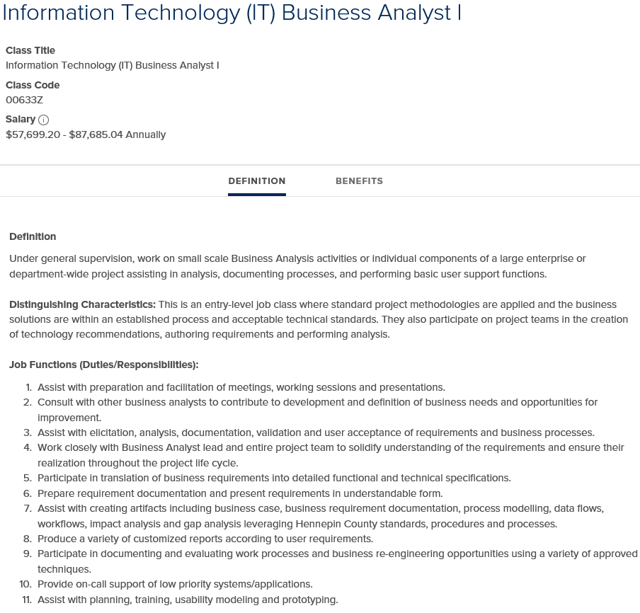
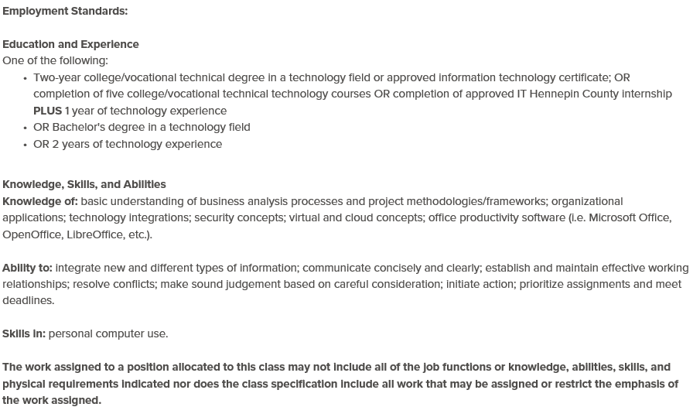
Job Classification Example:
How to set your image in the placeholder
Right click image and select “format picture”
Select “Picture” tab
Select Crop from the drop down menu
Under Picture Position, use the Offset X and Offset Y to position your image within the frame
delete this when no longer needed
Notes:
As of today, we have completed 4 job classes. They are IT Business Analyst, IT Project Manager, IT Enterprise Architecture and IT Developer.

Slide 11
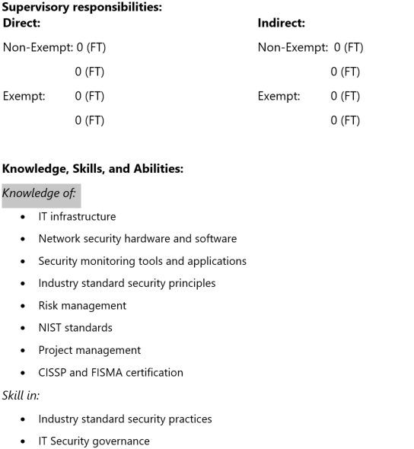
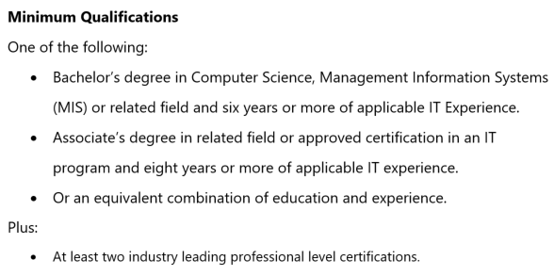
Job Description Example:
How to set your image in the placeholder
Right click image and select “format picture”
Select “Picture” tab
Select Crop from the drop down menu
Under Picture Position, use the Offset X and Offset Y to position your image within the frame
delete this when no longer needed
Notes:
As of today, we have completed 4 job classes. They are IT Business Analyst, IT Project Manager, IT Enterprise Architecture and IT Developer.

Slide 12
Completed Job Classes:
How to set your image in the placeholder
Right click image and select “format picture”
Select “Picture” tab
Select Crop from the drop down menu
Under Picture Position, use the Offset X and Offset Y to position your image within the frame
delete this when no longer needed
IT Business Analyst (April 15, 2017)
IT Project Manager (August 22, 2017)
IT Enterprise Architect (August 22, 2017)
IT Developer (December 10, 2017)
Notes:
As of today, we have completed 4 job classes. They are IT Business Analyst, IT Project Manager, IT Enterprise Architecture and IT Developer.

Slide 13
Future Job Classes & Descriptions:
How to set your image in the placeholder
Right click image and select “format picture”
Select “Picture” tab
Select Crop from the drop down menu
Under Picture Position, use the Offset X and Offset Y to position your image within the frame
delete this when no longer needed
IT Management
IT Analysts
IT Engineering
IT Administrator
IT Business Relationship Managers
Digital Forensic Investigator
Notes:
For the rest of 2017 and into Q1 of 2018, we will be focusing on the following job classes and job descriptions that align with the IT job class:
IT Management
IT Analysts
IT Operations
Digital Forensic Investigator
By updating job descriptions, we’re re-evaluating minimum qualifications to break down barriers and expand hiring opportunities. Updating job descriptions allows current staff to meet existing and future technology trends by:
Creating more defined sets of duties
Establishing expectations for staff performance
Defining core skills to enable current success and plan for the future
Adjusting pay scales to be more compatible with market standards
During the job description update, a Human Resources compensation analyst conducts a study comparing pay scales in:
Counties similar to Hennepin County
The IT Industry
Public sector guidelines
The result is an updated pay scale for the updated job description. When the study is complete, you will receive information about your updated pay scale. The full report is owned by Human Resources and is not posted or shared.

Slide 14
IT Analyst:
How to set your image in the placeholder
Right click image and select “format picture”
Select “Picture” tab
Select Crop from the drop down menu
Under Picture Position, use the Offset X and Offset Y to position your image within the frame
delete this when no longer needed
Roles:
IT Quality Assurance Analyst
IT Technical Analyst
IT Support Analyst
IT Vendor Analyst
IT Strategic Analyst
IT Technical Process Analyst (focuses on ITSM)
Notes:
For the rest of 2017 and into Q1 of 2018, we will be focusing on the following job classes and job descriptions that align with the IT job class:
IT Management
IT Analysts
IT Operations
Digital Forensic Investigator
By updating job descriptions, we’re re-evaluating minimum qualifications to break down barriers and expand hiring opportunities. Updating job descriptions allows current staff to meet existing and future technology trends by:
Creating more defined sets of duties
Establishing expectations for staff performance
Defining core skills to enable current success and plan for the future
Adjusting pay scales to be more compatible with market standards
During the job description update, a Human Resources compensation analyst conducts a study comparing pay scales in:
Counties similar to Hennepin County
The IT Industry
Public sector guidelines
The result is an updated pay scale for the updated job description. When the study is complete, you will receive information about your updated pay scale. The full report is owned by Human Resources and is not posted or shared.

Slide 15
IT Administrator:
How to set your image in the placeholder
Right click image and select “format picture”
Select “Picture” tab
Select Crop from the drop down menu
Under Picture Position, use the Offset X and Offset Y to position your image within the frame
delete this when no longer needed
Roles:
IT Administrator
IT Data Administrator
IT Network Administrator
Notes:
For the rest of 2017 and into Q1 of 2018, we will be focusing on the following job classes and job descriptions that align with the IT job class:
IT Management
IT Analysts
IT Operations
Digital Forensic Investigator
By updating job descriptions, we’re re-evaluating minimum qualifications to break down barriers and expand hiring opportunities. Updating job descriptions allows current staff to meet existing and future technology trends by:
Creating more defined sets of duties
Establishing expectations for staff performance
Defining core skills to enable current success and plan for the future
Adjusting pay scales to be more compatible with market standards
During the job description update, a Human Resources compensation analyst conducts a study comparing pay scales in:
Counties similar to Hennepin County
The IT Industry
Public sector guidelines
The result is an updated pay scale for the updated job description. When the study is complete, you will receive information about your updated pay scale. The full report is owned by Human Resources and is not posted or shared.

Slide 16
IT Engineering:
How to set your image in the placeholder
Right click image and select “format picture”
Select “Picture” tab
Select Crop from the drop down menu
Under Picture Position, use the Offset X and Offset Y to position your image within the frame
delete this when no longer needed
Roles:
IT Data Engineer
IT Infrastructure Engineer
IT Software Engineer
IT Network Engineer
Notes:
For the rest of 2017 and into Q1 of 2018, we will be focusing on the following job classes and job descriptions that align with the IT job class:
IT Management
IT Analysts
IT Operations
Digital Forensic Investigator
By updating job descriptions, we’re re-evaluating minimum qualifications to break down barriers and expand hiring opportunities. Updating job descriptions allows current staff to meet existing and future technology trends by:
Creating more defined sets of duties
Establishing expectations for staff performance
Defining core skills to enable current success and plan for the future
Adjusting pay scales to be more compatible with market standards
During the job description update, a Human Resources compensation analyst conducts a study comparing pay scales in:
Counties similar to Hennepin County
The IT Industry
Public sector guidelines
The result is an updated pay scale for the updated job description. When the study is complete, you will receive information about your updated pay scale. The full report is owned by Human Resources and is not posted or shared.

Slide 17
IT Business Relationship Manager:
How to set your image in the placeholder
Right click image and select “format picture”
Select “Picture” tab
Select Crop from the drop down menu
Under Picture Position, use the Offset X and Offset Y to position your image within the frame
delete this when no longer needed
Roles:
IT Business Relationship Manager
Three Levels
Entry
Experienced
Strategic/Expert
Notes:
For the rest of 2017 and into Q1 of 2018, we will be focusing on the following job classes and job descriptions that align with the IT job class:
IT Management
IT Analysts
IT Operations
Digital Forensic Investigator
By updating job descriptions, we’re re-evaluating minimum qualifications to break down barriers and expand hiring opportunities. Updating job descriptions allows current staff to meet existing and future technology trends by:
Creating more defined sets of duties
Establishing expectations for staff performance
Defining core skills to enable current success and plan for the future
Adjusting pay scales to be more compatible with market standards
During the job description update, a Human Resources compensation analyst conducts a study comparing pay scales in:
Counties similar to Hennepin County
The IT Industry
Public sector guidelines
The result is an updated pay scale for the updated job description. When the study is complete, you will receive information about your updated pay scale. The full report is owned by Human Resources and is not posted or shared.

Slide 18
IT Digital Forensics:
How to set your image in the placeholder
Right click image and select “format picture”
Select “Picture” tab
Select Crop from the drop down menu
Under Picture Position, use the Offset X and Offset Y to position your image within the frame
delete this when no longer needed
Roles:
IT Digital Forensics Investigator
Two Levels
Experienced
Expert
Notes:
For the rest of 2017 and into Q1 of 2018, we will be focusing on the following job classes and job descriptions that align with the IT job class:
IT Management
IT Analysts
IT Operations
Digital Forensic Investigator
By updating job descriptions, we’re re-evaluating minimum qualifications to break down barriers and expand hiring opportunities. Updating job descriptions allows current staff to meet existing and future technology trends by:
Creating more defined sets of duties
Establishing expectations for staff performance
Defining core skills to enable current success and plan for the future
Adjusting pay scales to be more compatible with market standards
During the job description update, a Human Resources compensation analyst conducts a study comparing pay scales in:
Counties similar to Hennepin County
The IT Industry
Public sector guidelines
The result is an updated pay scale for the updated job description. When the study is complete, you will receive information about your updated pay scale. The full report is owned by Human Resources and is not posted or shared.

Slide 19
IT Management:
How to set your image in the placeholder
Right click image and select “format picture”
Select “Picture” tab
Select Crop from the drop down menu
Under Picture Position, use the Offset X and Offset Y to position your image within the frame
delete this when no longer needed
Roles:
IT Supervisor
IT Manager
IT Division Manager
Notes:
For the rest of 2017 and into Q1 of 2018, we will be focusing on the following job classes and job descriptions that align with the IT job class:
IT Management
IT Analysts
IT Operations
Digital Forensic Investigator
By updating job descriptions, we’re re-evaluating minimum qualifications to break down barriers and expand hiring opportunities. Updating job descriptions allows current staff to meet existing and future technology trends by:
Creating more defined sets of duties
Establishing expectations for staff performance
Defining core skills to enable current success and plan for the future
Adjusting pay scales to be more compatible with market standards
During the job description update, a Human Resources compensation analyst conducts a study comparing pay scales in:
Counties similar to Hennepin County
The IT Industry
Public sector guidelines
The result is an updated pay scale for the updated job description. When the study is complete, you will receive information about your updated pay scale. The full report is owned by Human Resources and is not posted or shared.

Slide 20
HR Market Study

Slide 21
Incentive Pay:
How to set your image in the placeholder
Right click image and select “format picture”
Select “Picture” tab
Select Crop from the drop down menu
Under Picture Position, use the Offset X and Offset Y to position your image within the frame
delete this when no longer needed
Requires a justification form
Approval process (supervisor approval, manager approval, BIO or CIO approval)
Part of the employee’s annual performance review
Employee has to be meeting all criteria to be eligible
Notes:
Incentive pay is a way to reward staff who are focused on developing their skills. Managers/supervisors have the option to give out an performance incentive pay in addition to the annual performance review increase applied to an employee’s base salary. Incentive Pay is determined by IT Job class. Incentive pay is considered at each performance review period and does not become part of base salary.
All information regarding eligibility requirements and the incentive pay process is located here.

Slide 22
Incentive Pay:
How to set your image in the placeholder
Right click image and select “format picture”
Select “Picture” tab
Select Crop from the drop down menu
Under Picture Position, use the Offset X and Offset Y to position your image within the frame
delete this when no longer needed
Employee has to meet these requirements:
An active IDP
Is rated as a 'Strategic Performer' in Apex as part of their annual review process/rating
Employee is demonstrating excellence in Hennepin County's Core Values
Employee is demonstrating excellence in Employee Competencies
Notes:
All staff in IT job classes are required to have an up to date IDP. Use your IDP to guide conversations with your manager or supervisor about your professional development. You must have an up to date IDP in order to be considered for incentive pay.

Slide 23
Employee Mapping:
How to set your image in the placeholder
Right click image and select “format picture”
Select “Picture” tab
Select Crop from the drop down menu
Under Picture Position, use the Offset X and Offset Y to position your image within the frame
delete this when no longer needed
Gathered list from HR for each department
Meeting with manager/supervisor to interview to understand job functions for employees
Mapped employees to new job classes based on job function
HR completes a compensation analysis
Leadership to review employee impact and department impact
Mapped employees to new job classes based on job function

Slide 24
Implementation:
How to set your image in the placeholder
Right click image and select “format picture”
Select “Picture” tab
Select Crop from the drop down menu
Under Picture Position, use the Offset X and Offset Y to position your image within the frame
delete this when no longer needed
Strong partnership with HR and Leadership
SharePoint site for employees to go to for resources
Job descriptions
Incentive pay information
Q & A
Q & A document to hand out to employees
Employees letters
Grouped employees by job class
Supervisors/Managers 1:1’s with employees
One Day

Slide 25
Lessons Learned:
How to set your image in the placeholder
Right click image and select “format picture”
Select “Picture” tab
Select Crop from the drop down menu
Under Picture Position, use the Offset X and Offset Y to position your image within the frame
delete this when no longer needed
Prepare your managers and supervisors for difficult conversations
Talking points are required for all levels explain the why, resources and key dates
Consistent language and messaging
Employees letters (highly recommended)
Grouped employees by job class
Shorter timeframe from start to finish
Understand how the salary will impact things like PERA, Incentive Pay, Retention Pay, vacation/sick time payout, etc.
HR Union Director needs to be aware

Slide 26
Future:
How to set your image in the placeholder
Right click image and select “format picture”
Select “Picture” tab
Select Crop from the drop down menu
Under Picture Position, use the Offset X and Offset Y to position your image within the frame
delete this when no longer needed
Alignment with Workforce Development and Organizational Change Management to implement out the job classes
Revised PDQ process
Create performance indicators to enhance our performance management process
Develop career paths and training programs
Completed Job Descriptions and Job Classes by Q4 of 2018

Slide 27
Questions

Slide 28
Contact Information:
Nicole West
Nicole.West@hennepin.us
612-543-2975

