Slide 1
WANTED – People committed to solving our information security language problem
Evan Francen, CEO and Co-Founder
SecurityStudio and FRSecure

Slide 2
WANTED – People committed to solving our information security language problem
Why?
The power of unity and speaking the same language is powerful, and some (me/I) would say critical to solving big problems.
Let’s demonstrate with a simple question, the present a solution that shows the power.
How do we secure Minnesota?

Slide 3
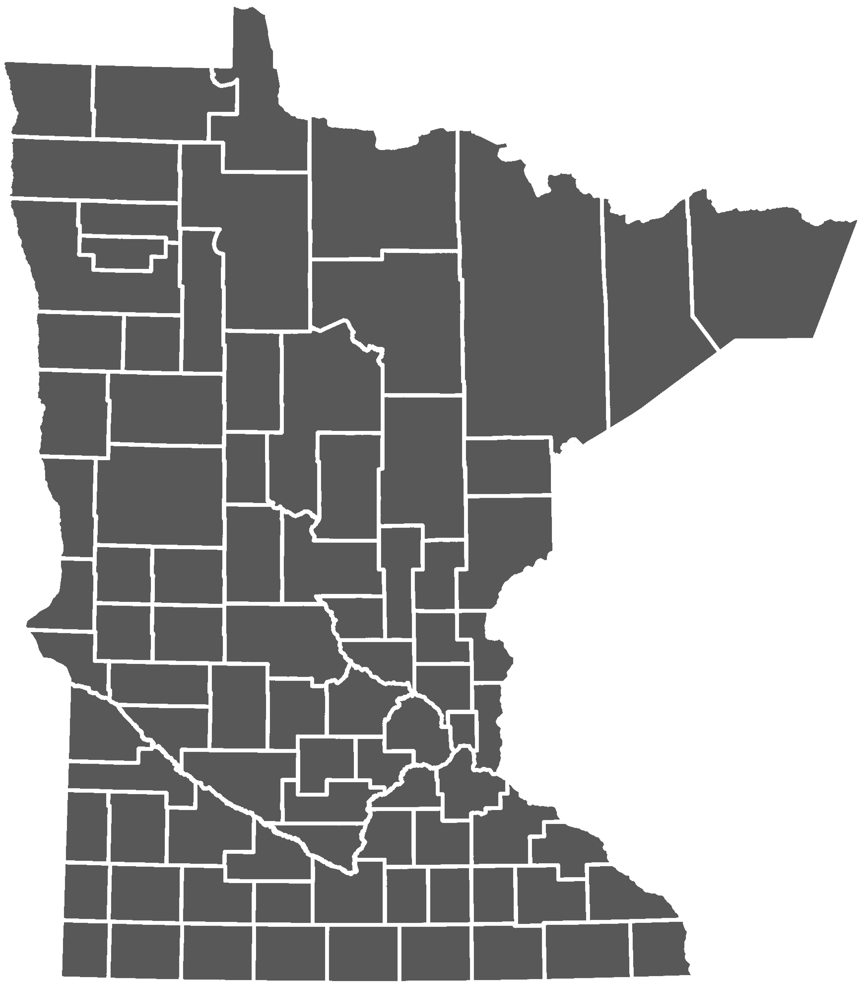
Here’s Minnesota.
→

Slide 4
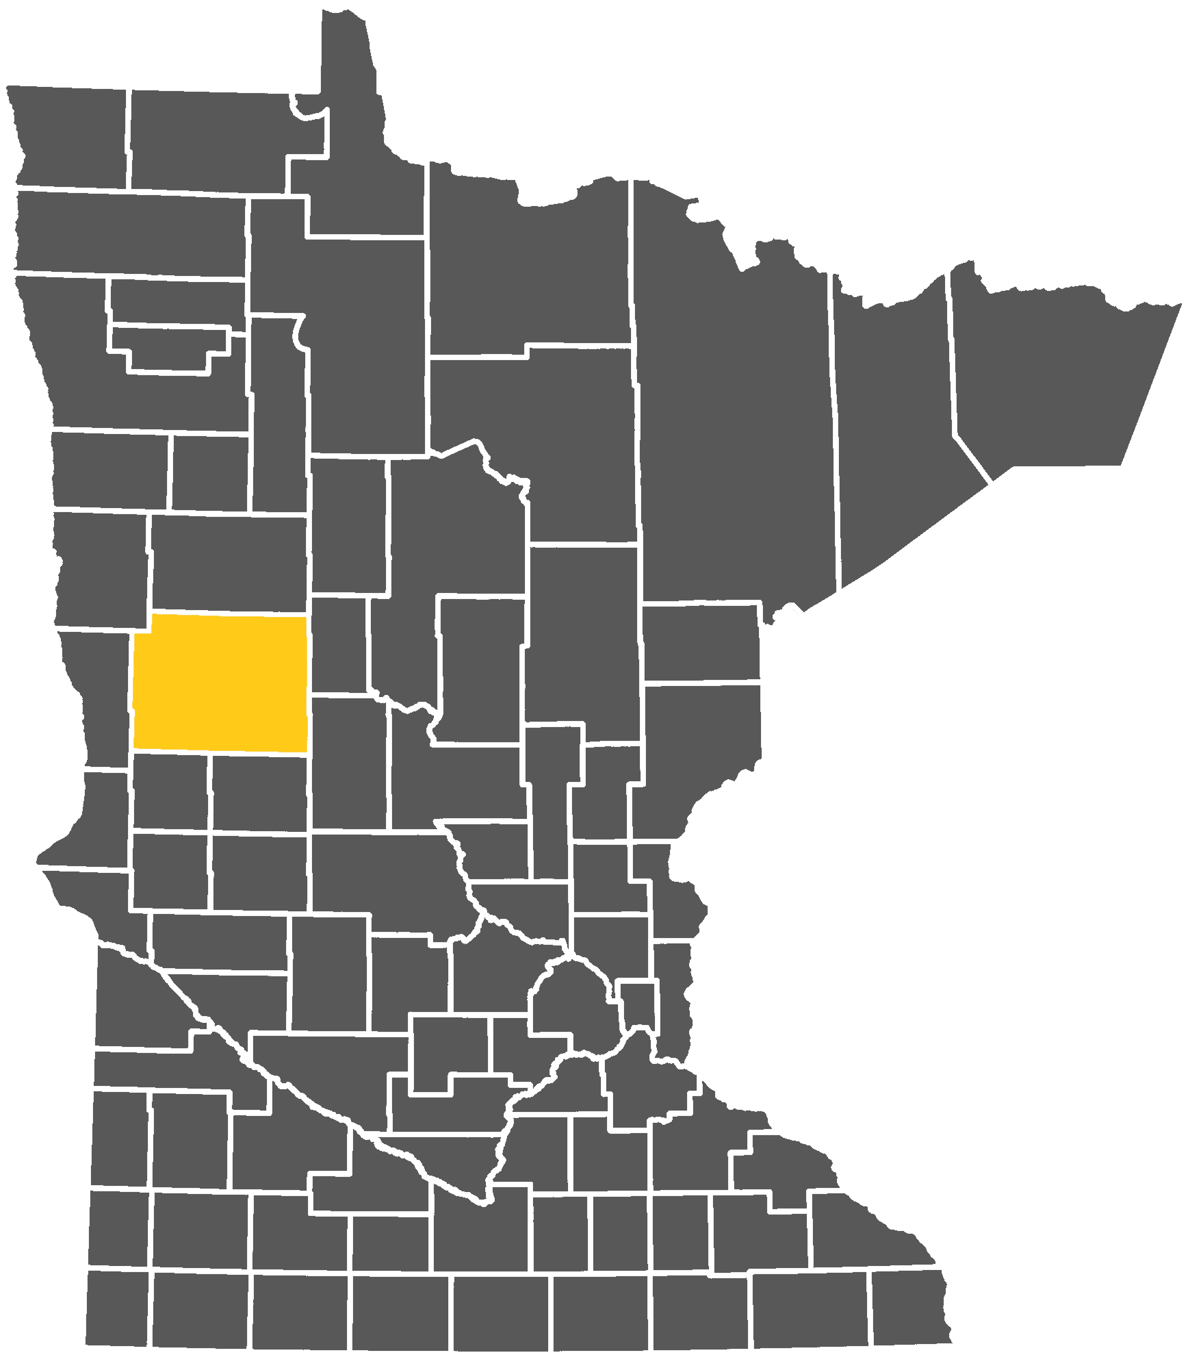
Ottertail County speaks their language.
→

Slide 5
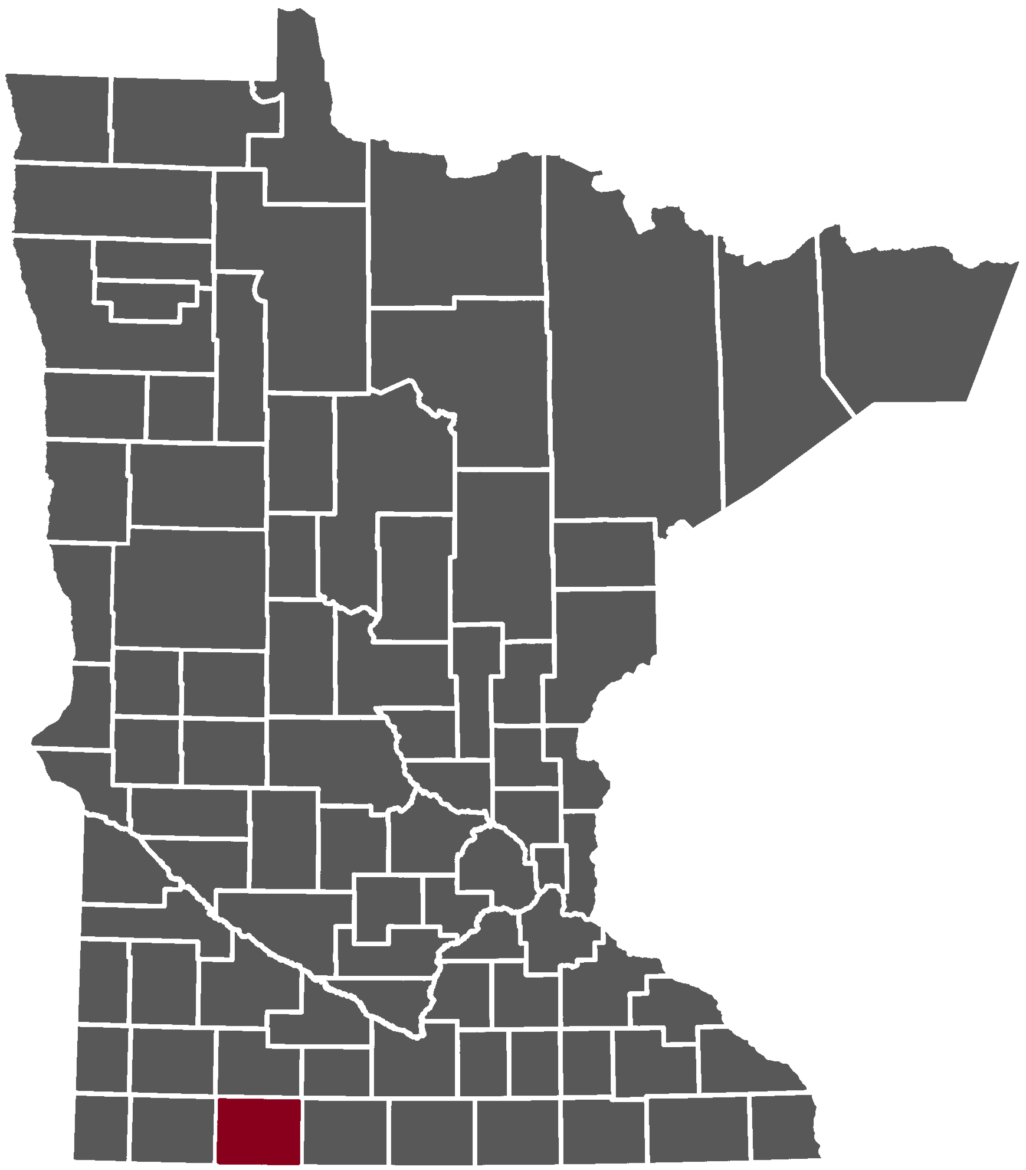
Jackson County speaks their language.
→

Slide 6
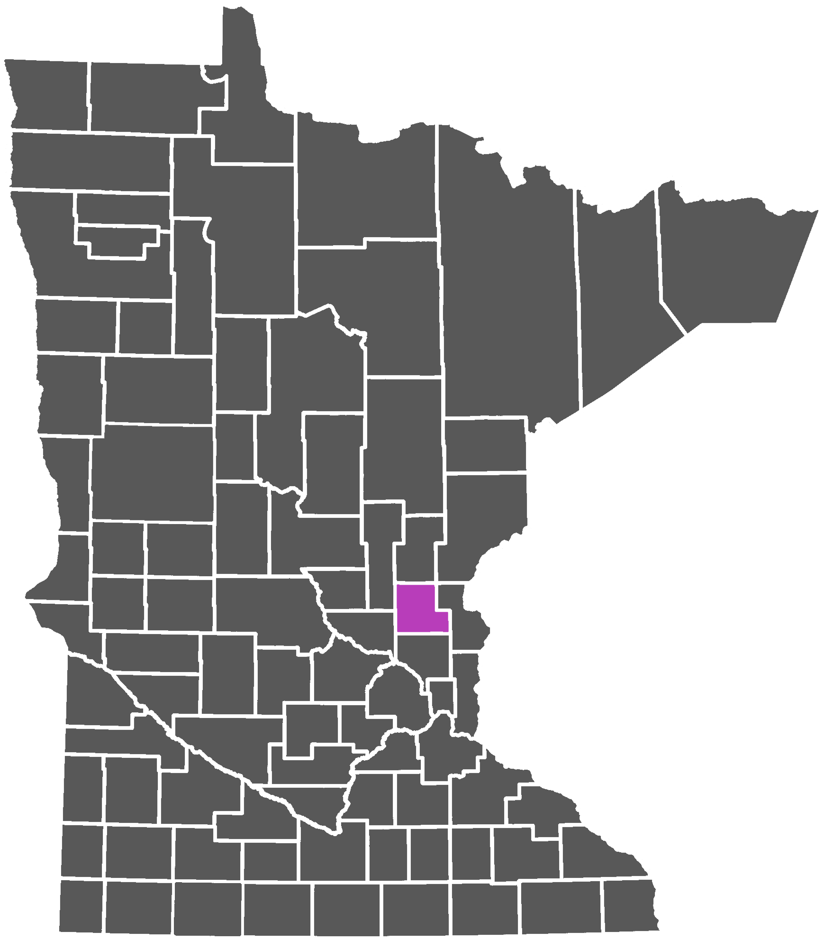
Isanti County speaks their language.
→

Slide 7
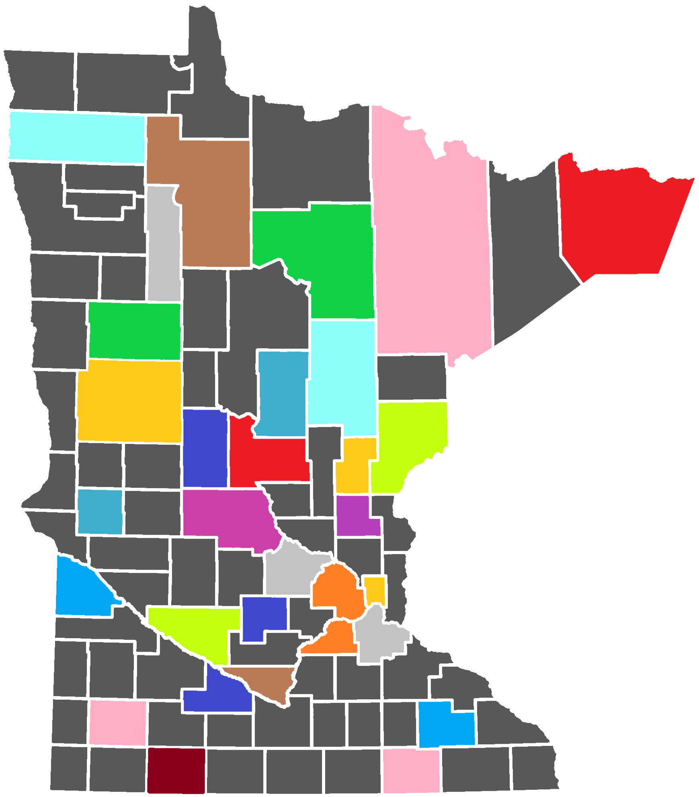
87 counties, all speaking something (or nothing)
→

Slide 8
You can’t manage this!
→
?

Slide 9
Start again. Define a common language and measurement first.

Slide 10
>780 (Excellent)
660 – 779 (Good)
600 – 659 (Fair)
500 – 599 (Poor)
< 500 (Very Poor)
>780 (Excellent)
660 – 779 (Good)
600 – 659 (Fair)
500 – 599 (Poor)
< 500 (Very Poor)
?

Slide 11
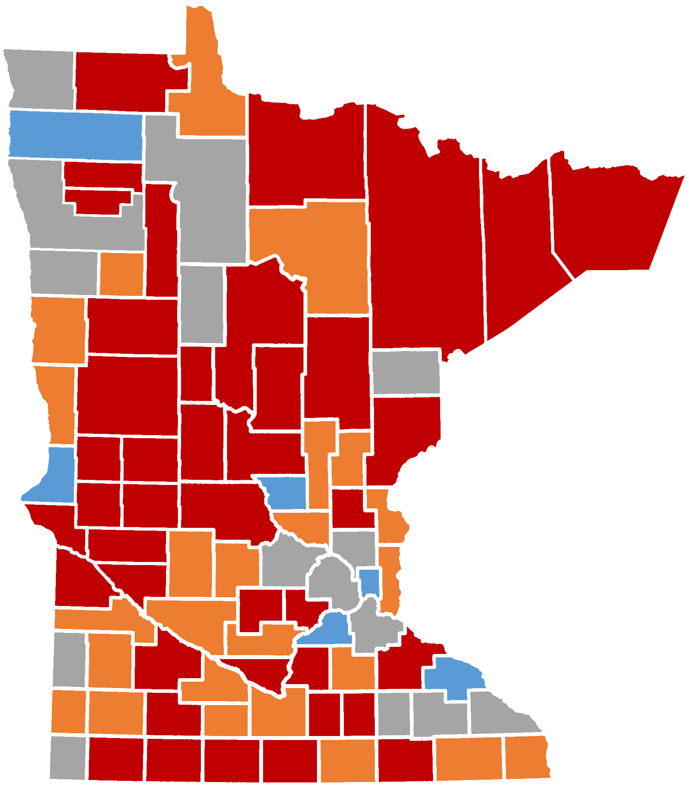
>780 (Excellent)
660 – 779 (Good)
600 – 659 (Fair)
500 – 599 (Poor)
497 (Very Poor)
>780 (Excellent)
660 – 779 (Good)
600 – 659 (Fair)
500 – 599 (Poor)
< 500 (Very Poor)

Slide 12
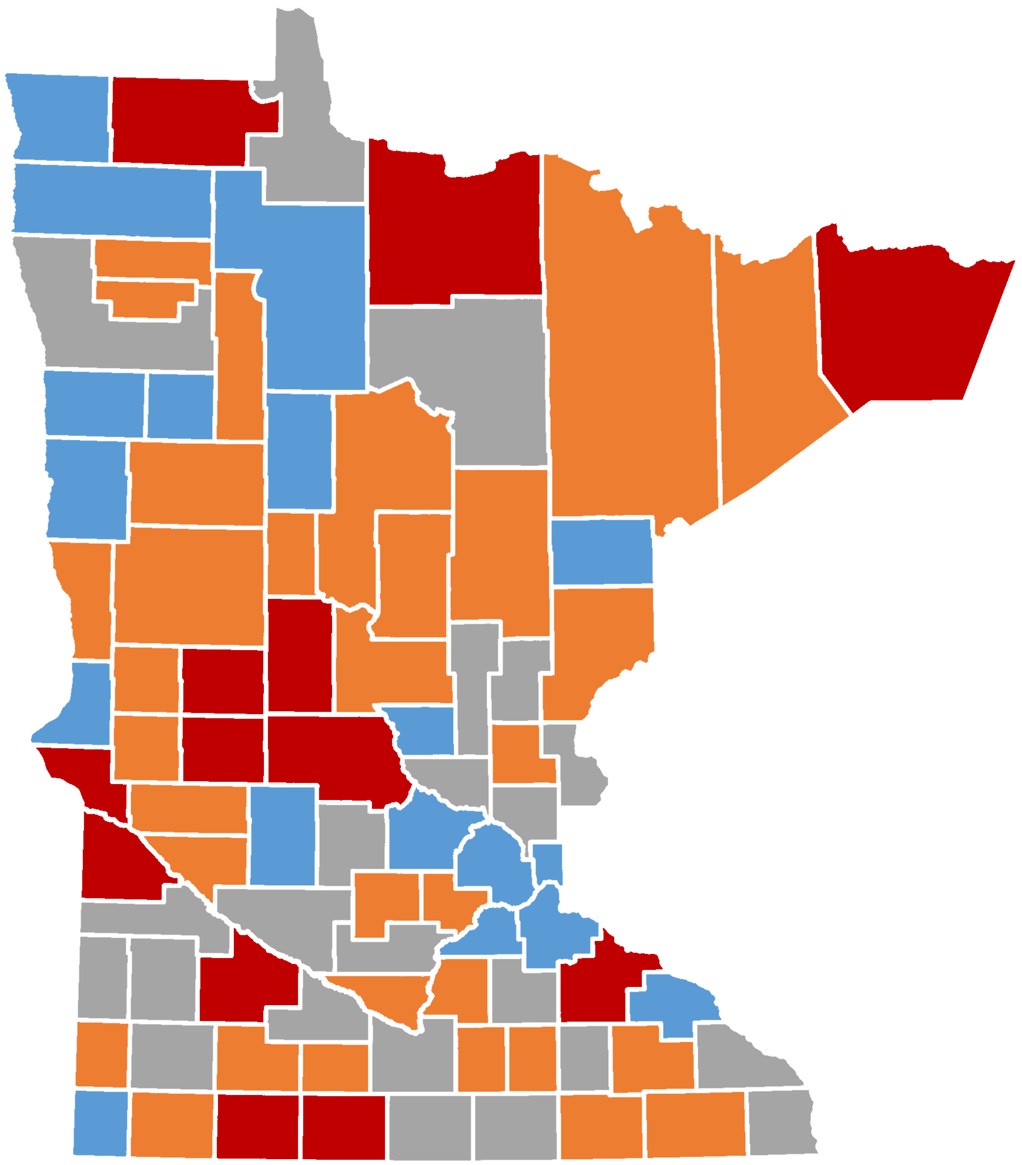
>780 (Excellent)
660 – 779 (Good)
600 – 659 (Fair)
553 (Poor)
497 (Very Poor)
>780 (Excellent)
660 – 779 (Good)
600 – 659 (Fair)
500 – 599 (Poor)
< 500 (Very Poor)

Slide 13
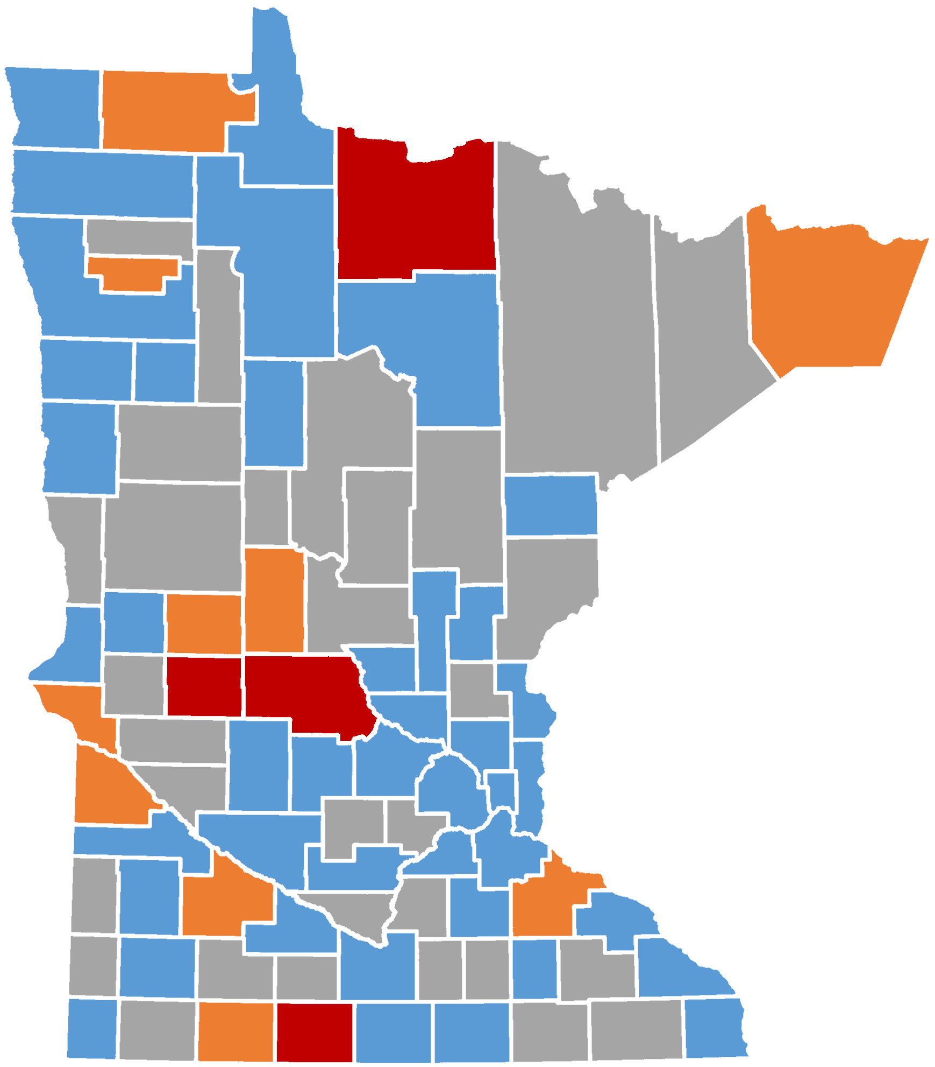
>780 (Excellent)
660 – 779 (Good)
637 (Fair)
553 (Poor)
497 (Very Poor)
>780 (Excellent)
660 – 779 (Good)
600 – 659 (Fair)
500 – 599 (Poor)
< 500 (Very Poor)

Slide 14
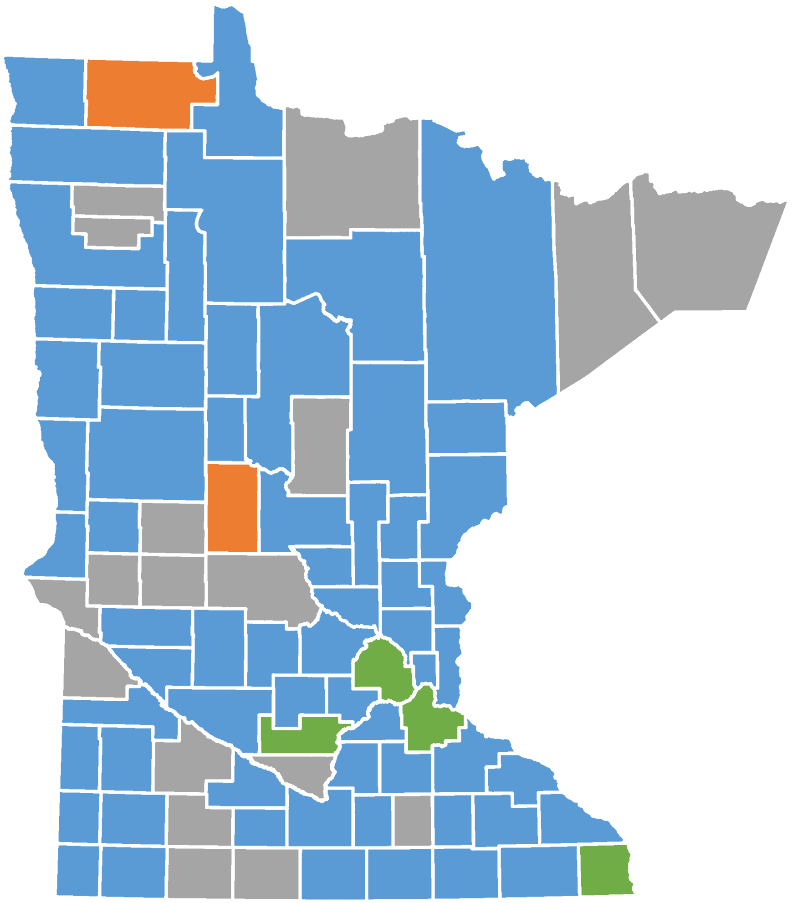
>780 (Excellent)
662 (Good)
637 (Fair)
553 (Poor)
497 (Very Poor)
>780 (Excellent)
660 – 779 (Good)
600 – 659 (Fair)
500 – 599 (Poor)
< 500 (Very Poor)

Slide 15
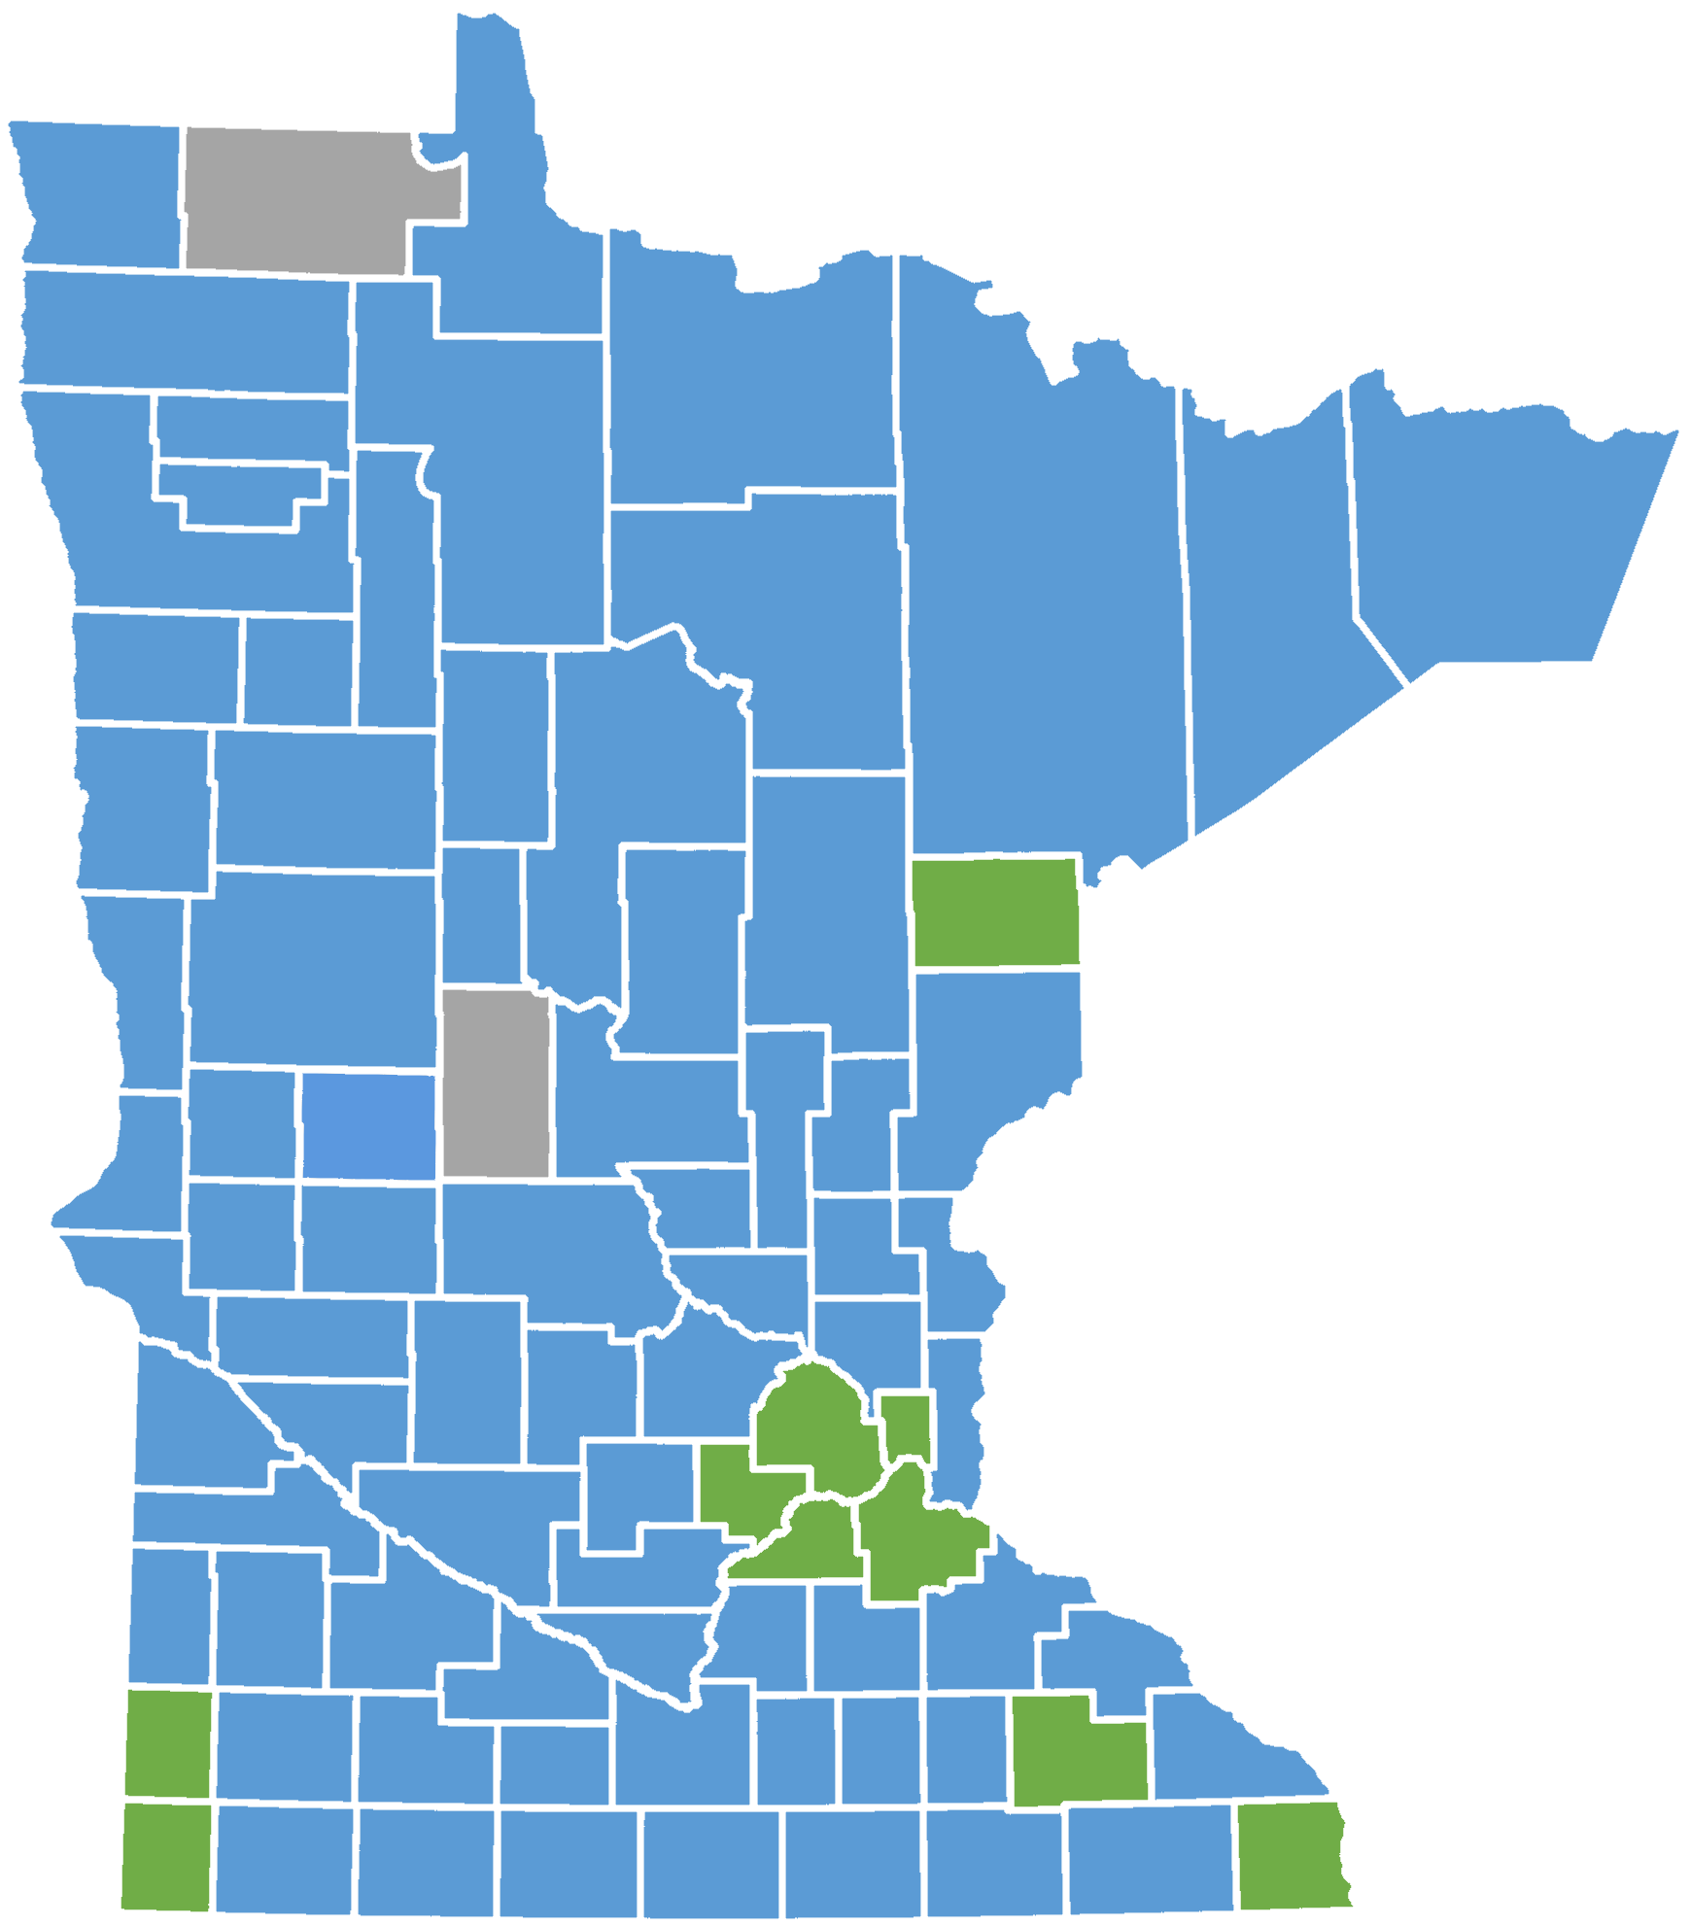
>780 (Excellent)
714 (Good)
637 (Fair)
553 (Poor)
497 (Very Poor)
>780 (Excellent)
660 – 779 (Good)
600 – 659 (Fair)
500 – 599 (Poor)
< 500 (Very Poor)

Slide 16
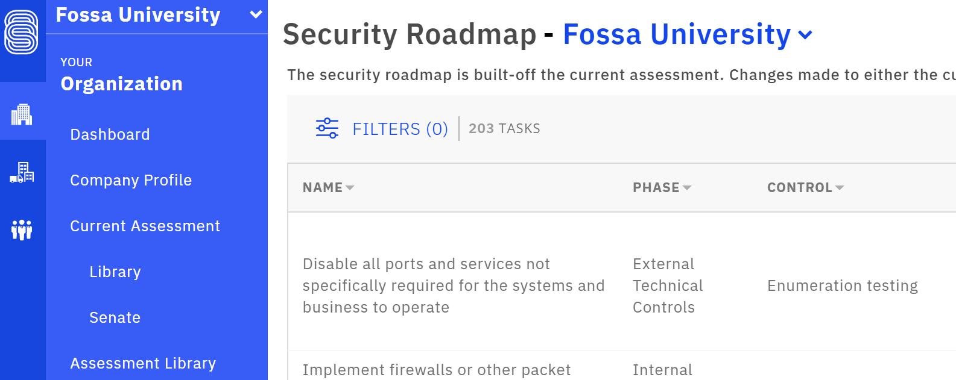
A common language, and application, allows you to transition from one state (in this case, Very Poor) to another state (in this case, Good).
>780 (Excellent)
660 – 779 (Good)
600 – 659 (Fair)
500 – 599 (Poor)
497 (Very Poor)
…but how?
>780 (Excellent)
714 (Good)
637 (Fair)
553 (Poor)
497 (Very Poor)
Simple.
SecurityStudio’s S2Org

Slide 17
A common language, and application, allows you to transition from one state (in this case, Very Poor) to another state (in this case, Good).
>780 (Excellent)
660 – 779 (Good)
600 – 659 (Fair)
500 – 599 (Poor)
497 (Very Poor)
…but how?
>780 (Excellent)
714 (Good)
637 (Fair)
553 (Poor)
497 (Very Poor)
Simple.
SecurityStudio’s S2Org
It’s free.
It’s simple.
It’s compliant.
It’s credible.
There’s no catch.
https://securitystudio.com/
Thank you!
Questions?

