Slide 1
Ellen Wolter & Jacob Wascalus
Wilder Research
Build your own profile for your community with Minnesota Compass

Slide 2

What is Minnesota Compass?
Compass gives everyone in our state a common foundation to identify, understand, and act on issues that affect our communities.
@MNCompass

Slide 3
Consortium of Foundations Behind Minnesota Compass
3Mgives
Blue Cross and Blue Shield of Minnesota Foundation
Boston Scientific
Otto Bremer Trust
Bush Foundation
Greater Twin Cities United Way
Initiative Foundation
The Jay & Rose Phillips Family Foundation of Minnesota
Mardag Foundation
The McKnight Foundation
The Minneapolis Foundation
Northwest Minnesota Foundation
Saint Paul & Minnesota Foundation
Wells Fargo Foundation Minnesota
Amherst H. Wilder Foundation

Slide 4















Minnesota Compass Key Topics
Aging
Children & Youth
Civic Engagement
Demographics
Disparities
Early Childhood
Economy
Education
Environment
Health
Housing
Immigration
Public Safety
Transportation
Workforce
Notes:
Highlight the topics we track
Each topic has 2-3 key measures that we track overtime, getting as low in geography level as possible
Work with community advisory topics on all of the data that we track
Recently just added Arts and Culture as well; Gulgun was on our advisory committee
Let’s take a look
RUTH
You can find out more about your county, region, and state.
Demographics: Total population, race and age breakdowns,
Health: Disability, insurance coverage
Economy: Poverty, jobs, establishments, income
Housing: Homeownership, cost-burden
Immigration: Foreign born, language
Workforce: Edu attainment, % working
And more!

Slide 5

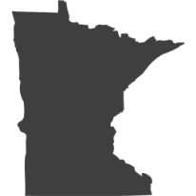


We do this by…
Providing unbiased and credible information
Tracking trends and measuring progress on issues in Minnesota's communities that impact our shared quality of life
Identifying disparities by including trend data by race, age, gender, and income
Providing additional resources for addressing issues
Notes:
PAUL

Slide 6
Why do we use data?
To uncover insights
To demonstrate need
To make the case to support my community
@MNCompass

Slide 7
Why do we use data?
To tell our story
@MNCompass

Slide 8
In Minnesota…
Today’s Agenda
How are our communities changing?
Build Your Own data tool: Learn about your community.

Slide 9

But first…
How are our
communities changing?
@MNCompass

Slide 10

Minnesota’s population grew by more than
16th
largest numeric increase
in the nation
300,000
residents between 2010 and 2018
@MNCompass
Notes:
SOURCES:
MN population growth: https://www.mncompass.org/demographics/population#1-5011-d
All states: https://www.mncompass.org/demographics/population#1-4961-d

Slide 11

1
@MNCompass
Notes:
SOURCE:
U.S. Census Bureau Population Estimates: https://www.census.gov/data/tables/time-series/demo/popest/2010s-state-total.html

Slide 12
Between 2010 and 2018, there were about…
570,000 births
342,000 deaths
Net gain of 228,000 Minnesotans
due to natural increase
@MNCompass
Notes:
SOURCE:
U.S. Census Bureau Population Estimates: https://www.census.gov/data/tables/time-series/demo/popest/2010s-state-total.html

Slide 13
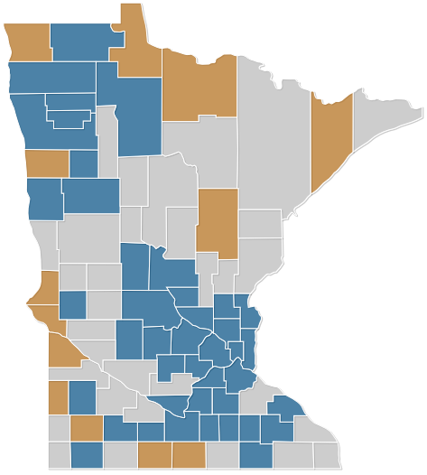
Natural change by county, 2010-2017
42 counties
experiencing natural increase
13 counties
experiencing natural decrease
■ Natural increase
■ No change
■ Natural decrease
@MNCompass
Notes:
SOURCE:
U.S. Census Bureau Population Estimates: https://www.census.gov/data/tables/2017/demo/popest/counties-total.html

Slide 14

Increasing share of births are to mothers of color…
1990
2000
2016
@MNCompass
Notes:
SOURCE: https://www.mncompass.org/early-childhood/low-birth-weight#1-5876-d

Slide 15
Minnesota’s population growth by racial and ethnic group, 2010-2017
@MNCompass
Notes:
SOURCE: https://www.mncompass.org/demographics/race#1-5523-d

Slide 16

2
@MNCompass
Notes:
SOURCE:
U.S. Census Bureau Population Estimates: https://www.census.gov/data/tables/time-series/demo/popest/2010s-state-total.html

Slide 17
Percentagewise, our foreign-born population remains below the peak of the late 1800s
37% of Minnesotans were foreign-born
15%
14%
9%
@MNCompass
Notes:
SOURCE: https://www.mncompass.org/immigration/population-trends#1-10779-g

Slide 18
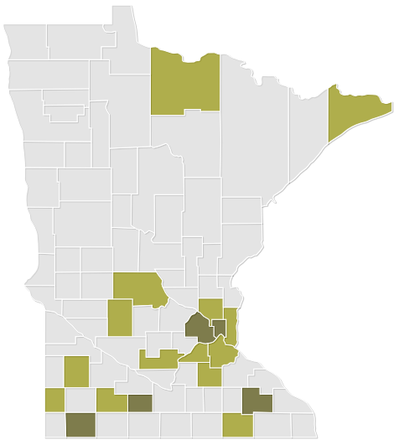
Percent foreign-born by county, 2013-17
5 counties
where at least
1 in 10 residents is foreign-born
Nobles
County
20%
■ 10% or more
■ 5 to 9%
■ Less than 5%
@MNCompass
Notes:
SOURCE: https://www.mncompass.org/immigration/population-trends#1-5138-g

Slide 19

3
@MNCompass
Notes:
SOURCE:
U.S. Census Bureau Population Estimates: https://www.census.gov/data/tables/time-series/demo/popest/2010s-state-total.html

Slide 20
Only recent net gains from domestic migration…
@MNCompass
Notes:
SOURCE:
U.S. Census Bureau Population Estimates: https://www.census.gov/data/tables/time-series/demo/popest/2010s-state-total.html

Slide 21
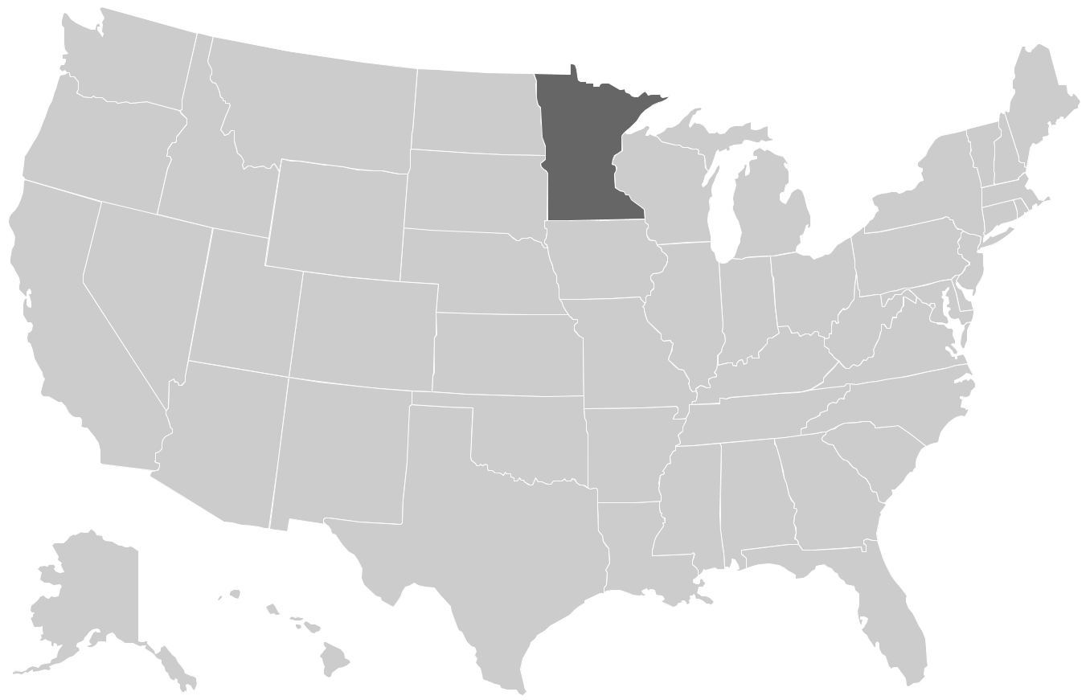
Since 2010, we’ve
LOST residents to…
North Dakota
Arizona
Texas
Florida
@MNCompass
Notes:
SOURCE:
U.S. Census Bureau, State-to-State Migration Flows: https://www.census.gov/data/tables/time-series/demo/geographic-mobility/state-to-state-migration.html

Slide 22
Since 2010, we’ve
GAINED residents from…
New York
Illinois
@MNCompass
Notes:
SOURCE:
U.S. Census Bureau, State-to-State Migration Flows: https://www.census.gov/data/tables/time-series/demo/geographic-mobility/state-to-state-migration.html

Slide 23
Questions?

Slide 24
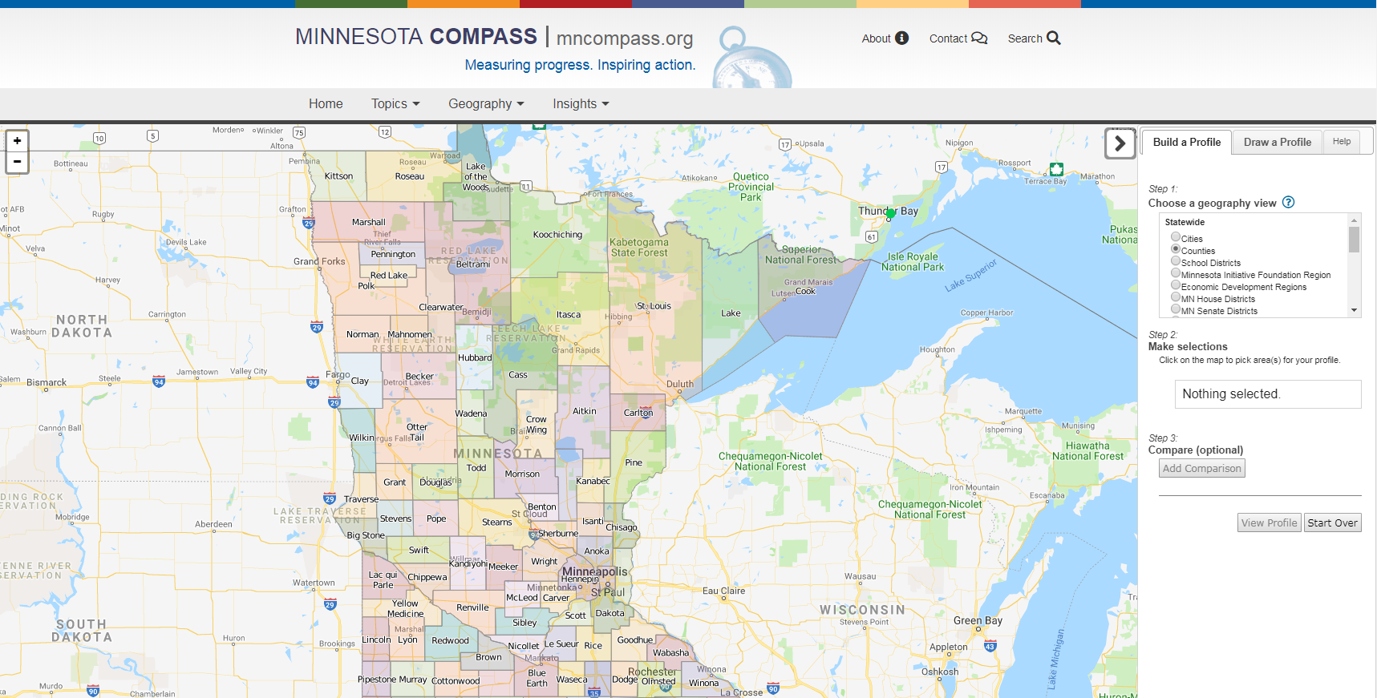
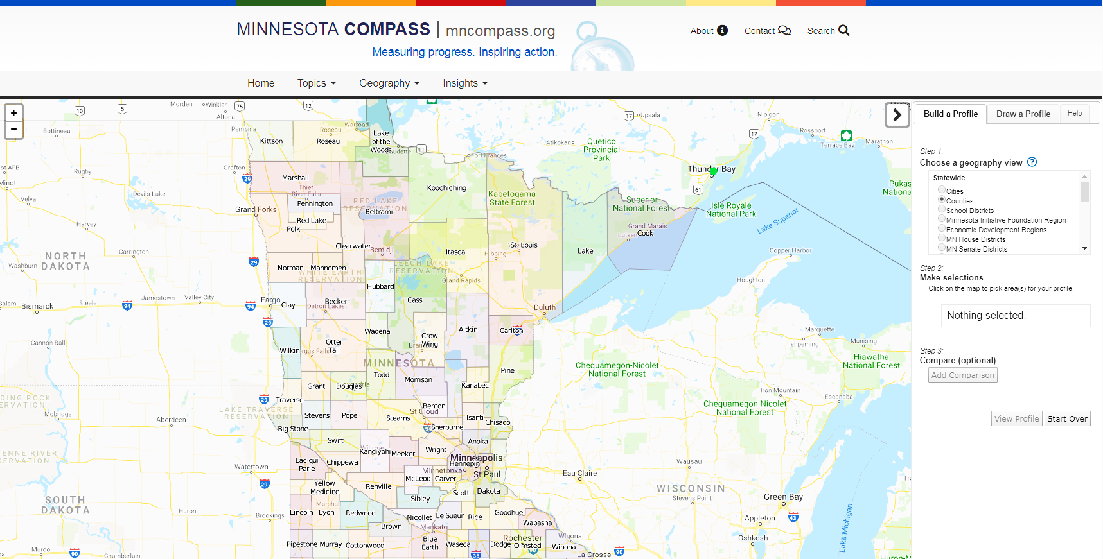
Improving access to data for greater Minnesota communities
@MNCompass

Slide 25
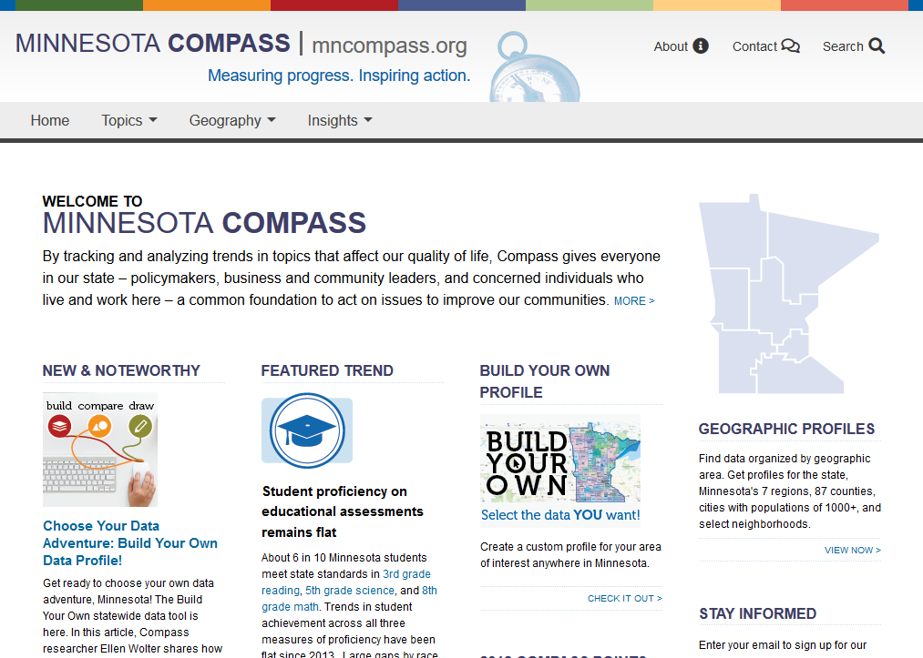
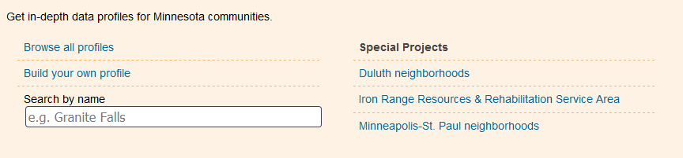
Geography mncompass.org
Notes:
This is where users can browse already-created profiles of different geographies or create their own geography.
I’ll get to that in a minute. I first want to show you some of these profiles we’ve already created. For many of you, this might be where you access most of the data you could need.
Census data,
Minnesota Department of Employment and Economic Development (DEED),
Longitudinal Employer-Household Dynamics (On the Map), which has information about workers, the cities where those workers are employed, and distance traveled.

Slide 26
Live Demo mncompass.org
Notes:
Census data, data from DEED, and data from Longitudinal Employer-Household Dynamics (On the Map). It has information about workers, the cities where those workers are employed, and distance traveled.

Slide 27
Test your skills
What percentage of Polk County’s housing stock is renter-occupied?
What percentage of Lake County’s workers are employed in manufacturing?
26.7%
10.5%
Notes:
Census data, data from DEED, and data from Longitudinal Employer-Household Dynamics (On the Map). It has information about workers, the cities where those workers are employed, and distance traveled.

Slide 28
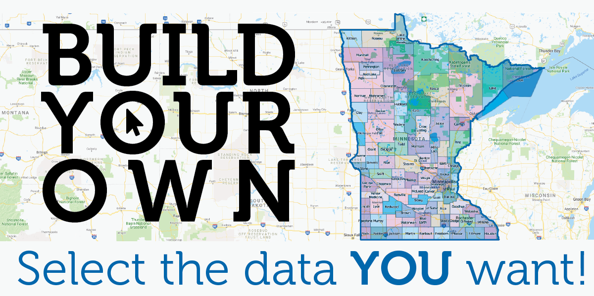

Slide 29

Choose your own data adventure
Using the Build your own data tool
#1 Build a Profile
#2 Compare Profiles
#3 Draw a Profile

Slide 30
Choose your own data adventure
Using the Build your own data tool
#1 Build a Profile

Slide 31
Live Demo mncompass.org
Notes:
Census data, data from DEED, and data from Longitudinal Employer-Household Dynamics (On the Map). It has information about workers, the cities where those workers are employed, and distance traveled.

Slide 32
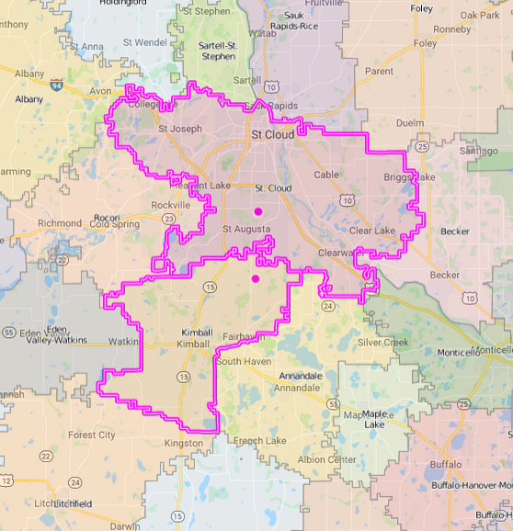
Test your skills
What is the sum of foreign-born residents in the St. Cloud and Kimball school districts?
(Bonus: What’s the margin of error?)
9,096
MoE: +/- 1,057
Notes:
Census data, data from DEED, and data from Longitudinal Employer-Household Dynamics (On the Map). It has information about workers, the cities where those workers are employed, and distance traveled.

Slide 33
Choose your own data adventure
Using the Build your own data tool
#2 Compare Profiles

Slide 34
Live Demo mncompass.org
Notes:
Census data, data from DEED, and data from Longitudinal Employer-Household Dynamics (On the Map). It has information about workers, the cities where those workers are employed, and distance traveled.

Slide 35
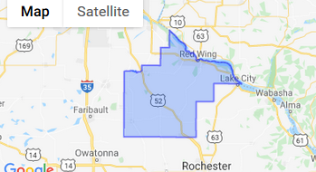
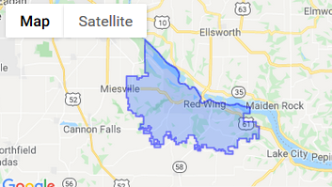
Test your skills
Of all of the kids 17 and younger in Goodhue County, what percentage of them live in the Red Wing School District?
MATH!!!
4,318 ÷ 10,502 x 100 = 41%
Notes:
Census data, data from DEED, and data from Longitudinal Employer-Household Dynamics (On the Map). It has information about workers, the cities where those workers are employed, and distance traveled.

Slide 36
Choose your own data adventure
Using the Build your own data tool
#3 Draw a Profile

Slide 37
Live Demo mncompass.org
Notes:
Census data, data from DEED, and data from Longitudinal Employer-Household Dynamics (On the Map). It has information about workers, the cities where those workers are employed, and distance traveled.

Slide 38
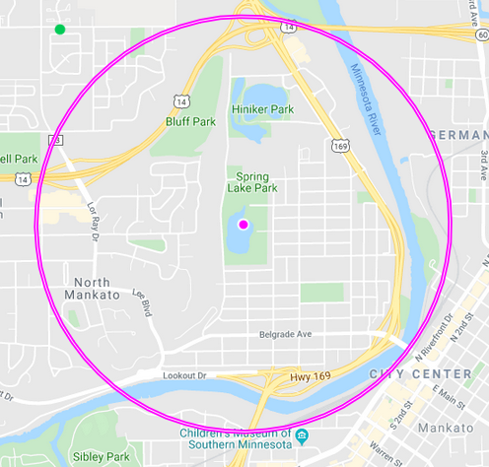
Test your skills
What is the approximate median household income of residents who live within 1 mile of
Spring Lake Park in Mankato?
~$57,000
MoE: ~ +/-$4,500
Notes:
Census data, data from DEED, and data from Longitudinal Employer-Household Dynamics (On the Map). It has information about workers, the cities where those workers are employed, and distance traveled.

Slide 39
Test your skills
Create profiles using the shape, line and, point drawing tools.
Notes:
Census data, data from DEED, and data from Longitudinal Employer-Household Dynamics (On the Map). It has information about workers, the cities where those workers are employed, and distance traveled.
https://leadership-dev.mncompass.org/leadership/overview

Slide 40
Continuing to work with communities across the state
Minnesota Compass Champions
Regional trend presentations, workshops, & webinars
More Greater Minnesota
research
Greater Minnesota Advisory
Council

Slide 41

How can you stay informed?
Sign up for our monthly e-newsletter
Follow us on Twitter @MNCompass
Connect with MN Compass on Facebook
@MNCompass

Slide 42


How can you be a part of our work moving forward?
Promote the use of Compass on your website, in your newsletter, and on social media
Connect Compass with community initiatives
@MNCompass
Notes:
[TRANSITION TO PAUL]

Slide 43


Improving how we tell greater Minnesota’s story
Notes:
EW NOTE: Change Picture

Slide 44
In Minnesota…
Agenda
Creating better data tools
Sharing the Build Your
Own tool
Continuing our work
@MNCompass

Slide 45

Alexandria
Austin
Bemidji
Brainerd
Crookston
Fergus Falls
Grand Rapids
Hibbing
Rochester
St. Cloud
Willmar
Worthington
@MNCompass
Notes:
You might remember that this past year we’ve been working on listening to communities across the state to learn what they need from Minnesota Compass.
Change graphic since it is the same as last year?

Slide 46
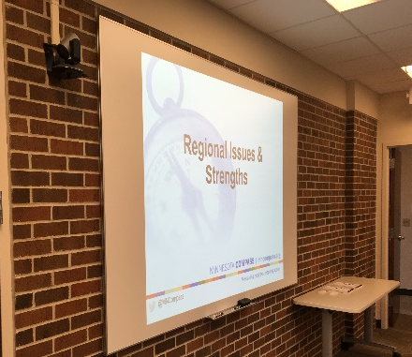
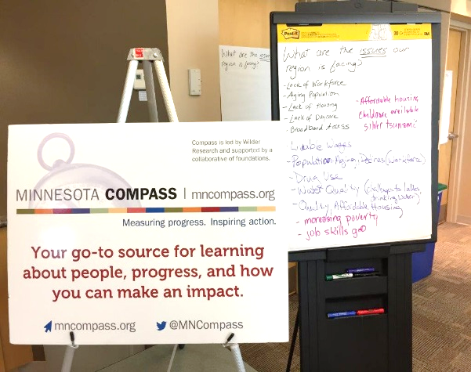
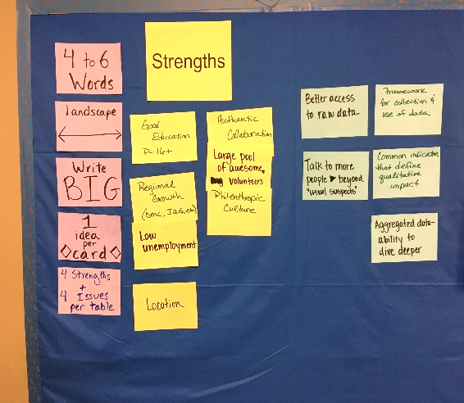
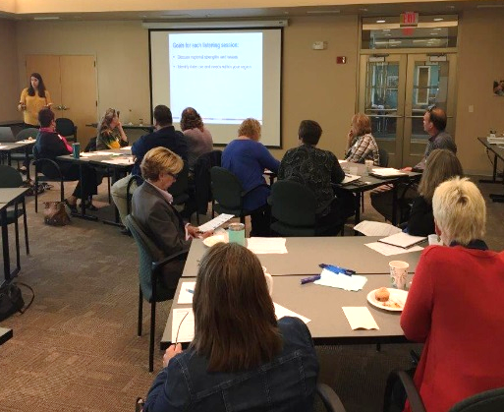
Listening sessions:
Discuss regional strengths and issues
Identify data use and needs
Gather feedback about tools
@MNCompass

Slide 47

What we heard…
Strengths
Growing racial and ethnic diversity
Education
Community
Strong economy
Natural resources
Arts and culture
Broadband access
High quality of life
Strong work ethic
Innovation
Issues
Cost of living not aligned with wages
Poverty
Aging population
Leadership vacuum
Resistance to demographic changes
Broadband expense and access
Workforce shortages
Childcare affordability and availability
Housing affordability and availability
Opioid epidemic
Protecting natural resources
@MNCompass
Notes:
INCLUDE THESE? MAYBE CHANGE THESE SO ALIGN WITH ALLISON’s TRENDS: CHANGE GRAPHIC
Residents see strength in community, their high quality of life, and their work ethic. Other strengths that emerged focused on education, arts and culture, innovation, and a strong economy.
Residents are challenged by workforce issues related to an aging population, a potential leadership vacuum, and potential workforce shortages. Related to work and economy, residents noted issues around poverty, childcare, and housing affordability and availability.
What you may note is that some things appear on both lists. This – in part – gets at the point that “There is more than one greater Minnesota.” For example, while broadband access may be a strength in communities that have affordable access, other regions of the state may lack access to high speed internet.
We’ll be sharing more in the coming months about what we heard from listening session attendees and how we plan to implement their feedback in terms of data and tools on the site. But as a start…

Slide 48
What we heard… about data needs in greater Minnesota
“ How many residents living in my Economic Development Region are without a car or are housing cost-burdened?”
“ How do educational attainment, unemployment, and poverty rates compare across school districts in my region?”
“How does my community fit into the bigger picture of the region?”
“ How many children in my five-county program service area live in poverty and how does it compare to the entire region?”
@MNCompass
Notes:
Easily benchmark to other areas
Access smaller areas such as school districts and neighborhoods that better reflect communities
Easily combine geographies into one profile

Slide 49
Alexandria
Austin
Bemidji
Brainerd
Crookston
Fergus Falls
Grand Rapids
Hibbing
Rochester
St. Cloud
Willmar
Worthington
“There’s
more than one greater Minnesota.”
@MNCompass
Notes:
Change graphic since it is the same as last year?

Slide 50
45% of Minnesotans
live in greater Minnesota
80 counties
751 cities and towns
282 school districts
734 zip codes
11 Native nations
And infinite other ways that greater Minnesotans define and draw their community boundaries
@MNCompass

Slide 51
Improving access to data for greater Minnesota communities
@MNCompass

Slide 52
@MNCompass
Notes:
Helping to shed a light on communities in greater Minnesota

Slide 53
Build your own profile data
Data Sources:
American Community Survey (5-year estimates)
Longitudinal Employment Household Dynamics Data
Decennial Census
Demographics
Housing
Economy
Health
Workforce
Education
Transportation
Immigration
@MNCompass
Notes:
Total Population
Race/Ethnicity
Age
Housing
Income and Poverty
Employment
Educational attainment
Transportation

Slide 54
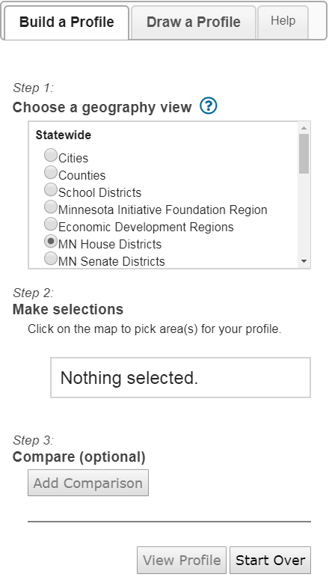
Data available for more greater Minnesota communities
Available geographies:
Counties
Cities
School districts
Minnesota Initiative
Foundation Region
Economic Development Region
MN House Districts
MN Senate Districts
US Congressional Districts
Zip codes
Census tracts

Slide 55
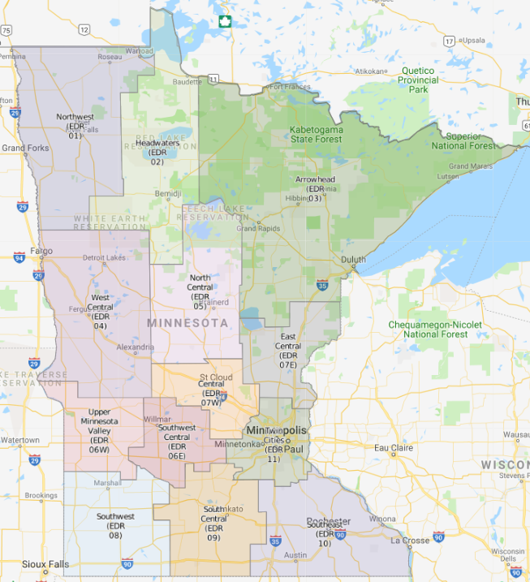
Notes:
Minnesota Legislative Districts
Minnesota Economic Development Regions
Minnesota Workforce Service Areas
Micropolitan areas
Rural urban commuting codes
Assign census tracts based on population size, density, and commuting or proximity to large or small urban centers. Identifies areas that are remote and may not benefit from population centers where there are resources.

Slide 56
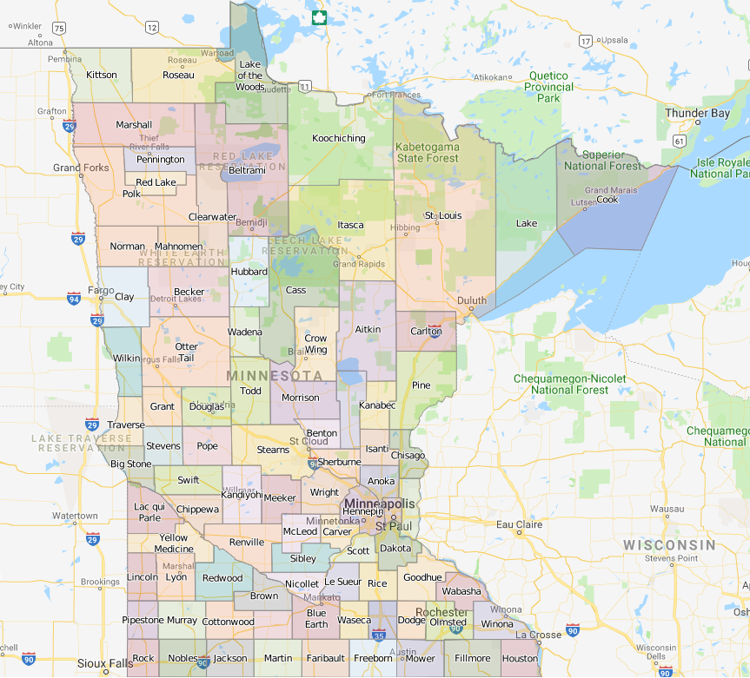
Notes:
Minnesota Legislative Districts
Minnesota Economic Development Regions
Minnesota Workforce Service Areas
Micropolitan areas
Rural urban commuting codes
Assign census tracts based on population size, density, and commuting or proximity to large or small urban centers. Identifies areas that are remote and may not benefit from population centers where there are resources.

Slide 57
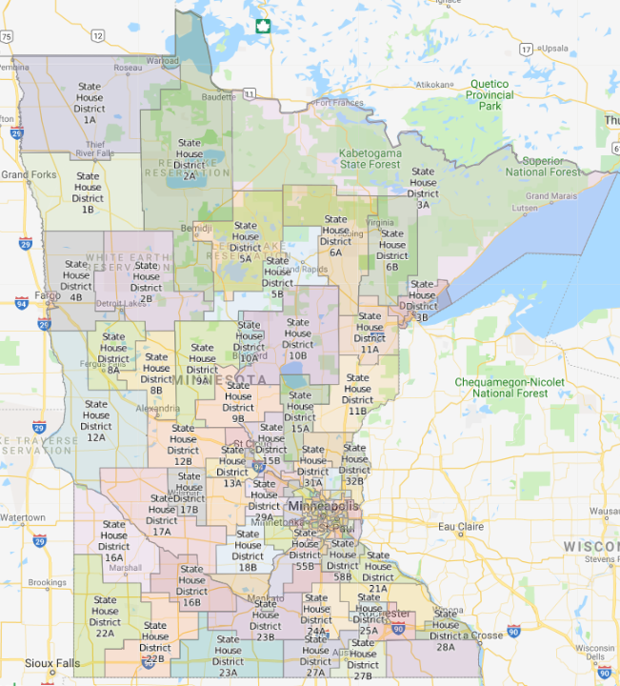
Notes:
Minnesota Legislative Districts
Minnesota Economic Development Regions
Minnesota Workforce Service Areas
Micropolitan areas
Rural urban commuting codes
Assign census tracts based on population size, density, and commuting or proximity to large or small urban centers. Identifies areas that are remote and may not benefit from population centers where there are resources.

Slide 58
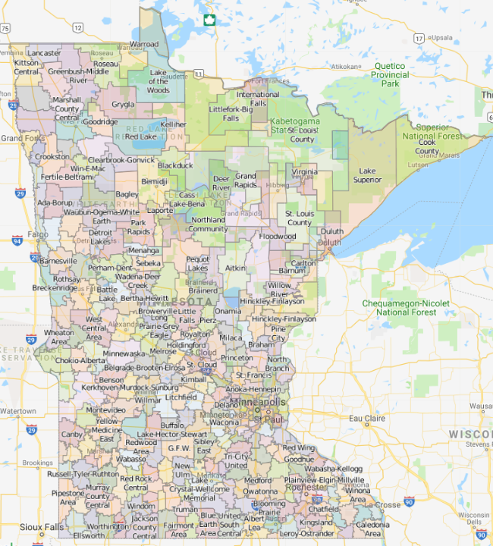
Notes:
Minnesota Legislative Districts
Minnesota Economic Development Regions
Minnesota Workforce Service Areas
Micropolitan areas
Rural urban commuting codes
Assign census tracts based on population size, density, and commuting or proximity to large or small urban centers. Identifies areas that are remote and may not benefit from population centers where there are resources.

Slide 59
Let’s see it in action!
@MNCompass

Slide 60

Choose your own data adventure
Using the Build your own data tool
#1 Build a Profile
#2 Compare Profiles
#3 Draw a Profile
@MNCompass
Notes:
List the four examples that we included in the Insight article
Highlight examples using United Way service areas
Share specific data points about each area to highlight different data options

Slide 61
Choose your own data adventure
Using the Build your own data tool
#1 Build a Profile
@MNCompass
Notes:
List the four examples that we included in the Insight article
Highlight examples using United Way service areas
Share specific data points about each area to highlight different data options

Slide 62
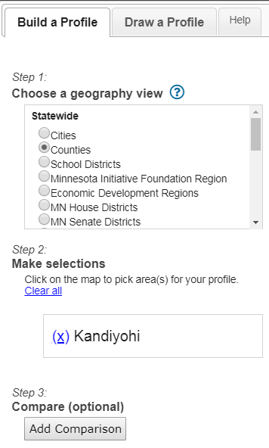
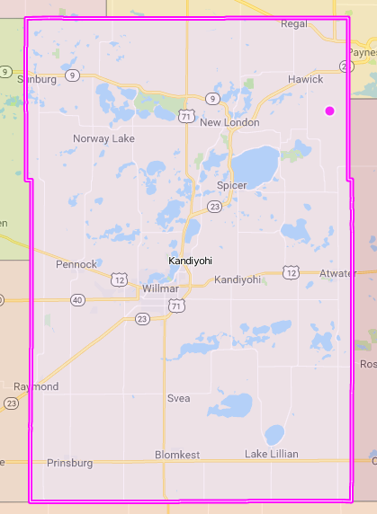
Adventure #1
Build a profile with
One geography
11%
live in poverty
17% of children under 17
live in poverty
29% of households
make less than $35,000
Kandiyohi
@MNCompass
Notes:
https://www.mncompass.org/profiles/custom/custom-profile?report_id=9c5036b79169b94e13109880355ed764

Slide 63
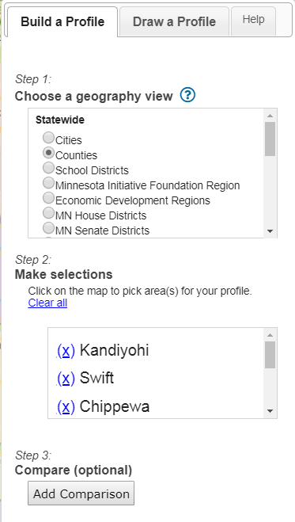
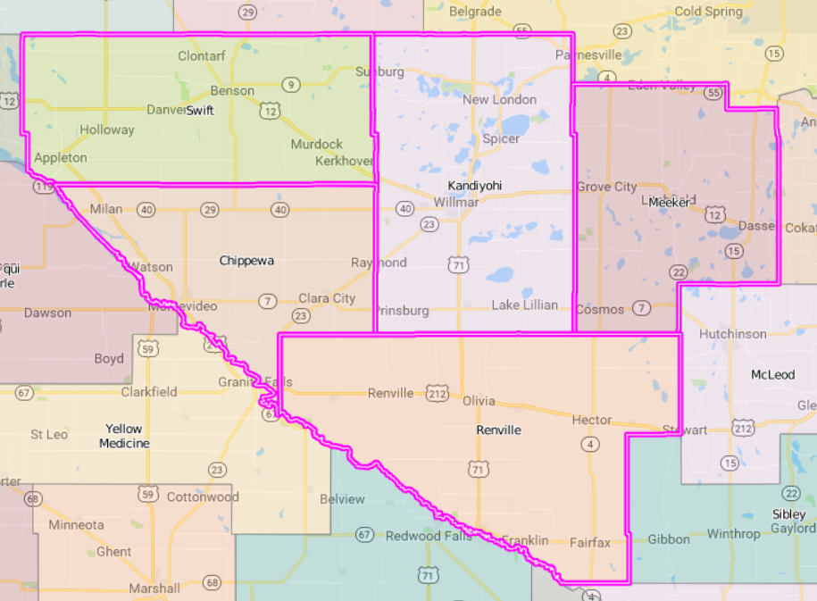
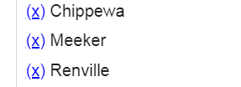
Adventure #1
Build a profile with
More than
one
geography
Swift
Meeker
Kandiyohi
Chippewa
11% live in poverty
15% of children under 17
live in poverty
30% of households
make less than $35,000
Renville
@MNCompass
Notes:
https://www.mncompass.org/profiles/custom/custom-profile?report_id=5e08dfb2d16ae474b0842b02f36224f0

Slide 64
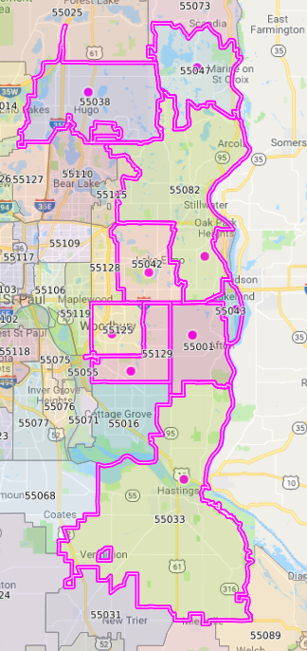
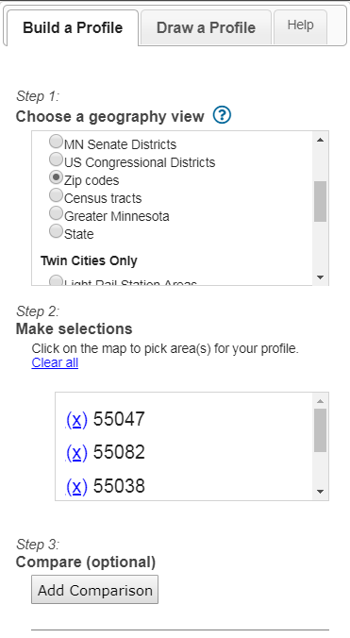
Adventure #1
More examples
Eastern Washington County United Way Service Area
@MNCompass
Notes:
Bookmarked Profile: https://www.mncompass.org/profiles/custom/custom-profile?report_id=b633b8287082569f3f33d90d01292a21

Slide 65
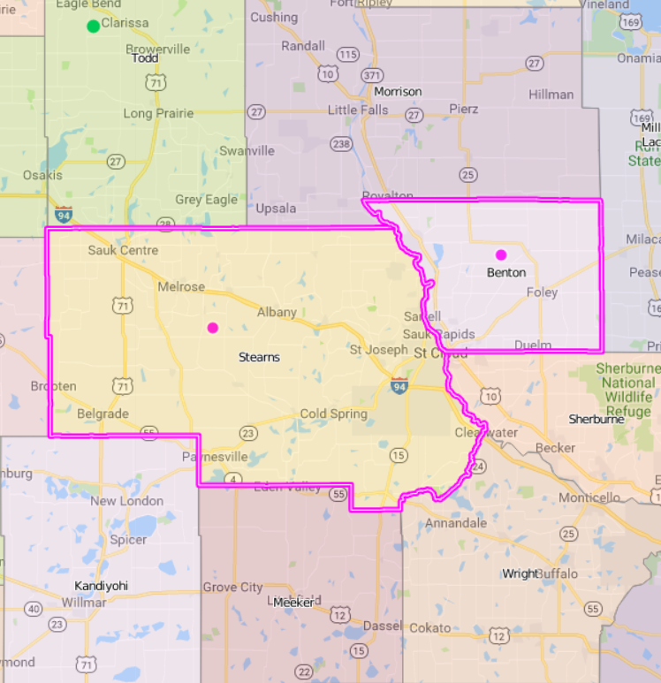
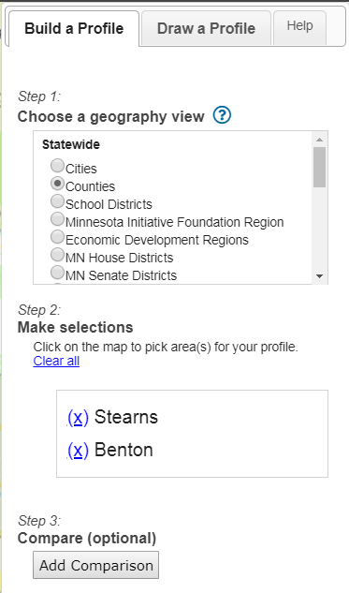
Adventure #1
More examples
St. Cloud
Area MSA
Benton
Stearns
@MNCompass
Notes:
Central United Way
Benton
Meeker
Morrison
Sherburne
Stearns
Wright
Greater Mankato Area

Slide 66
Choose your own data adventure
Using the Build your own data tool
#2 Compare Profiles
@MNCompass
Notes:
List the four examples that we included in the Insight article
Highlight examples using United Way service areas
Share specific data points about each area to highlight different data options

Slide 67
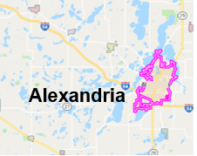
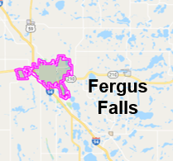
Adventure #2
  West Central EDR
Compare
Cities & Cities
Older adults living alone:
21%
Alexandria
  22%
  Fergus Falls
Notes:
The Compare Profiles option let’s users easily compare between cities or counties or other geographies of interest. Here is an example of a comparison profile between Alexandria and Fergus Falls, two similarly sized cities in the West Central Region. Again, I’m just going to provide an example of data available. If you are working on developing program related to older adults, you can find information on the percent of older adults living alone.
Bookmarked Profile: https://www.mncompass.org/profiles/custom/custom-profile?report_id=0270ab9b83fce1c5a4d9ca1f27da7fa7

Slide 68
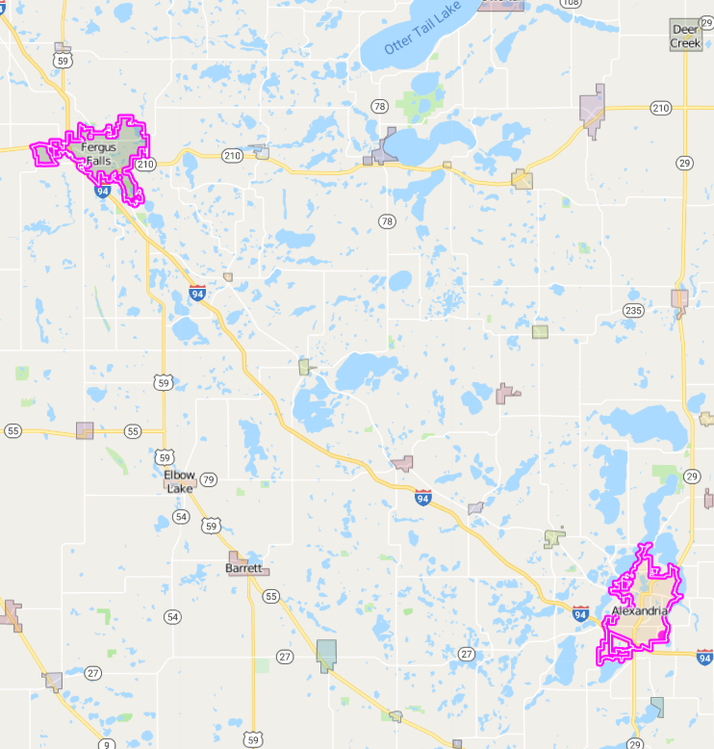
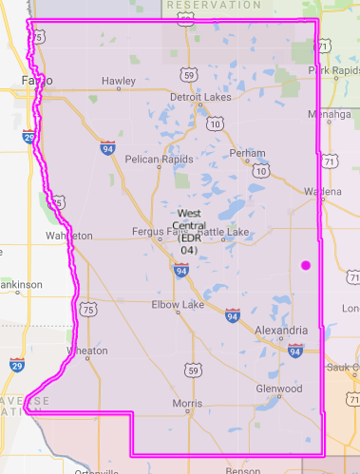
Adventure #2
Fergus Falls
Compare
Cities & Economic
Development
Regions
  West Central EDR
Alexandria
Older adults living alone:
22%
Alexandria & Fergus Falls
  13%
  West Central Economic Development Region
Notes:
You can also build a profile and then compare those profiles. This example combines the cities of Alexandria and Fergus Falls and then compares it to the West Central Economic Development Region. Again, this example is looking at older adults living alone and you can see that the percentage of older adults living alone is higher in Alexandria and Fergus Falls than it is in the West Central Economic Development Region as a whole.
Bookmarked Profile: https://www.mncompass.org/profiles/custom/custom-profile?report_id=0270ab9b83fce1c5a4d9ca1f27da7fa7

Slide 69
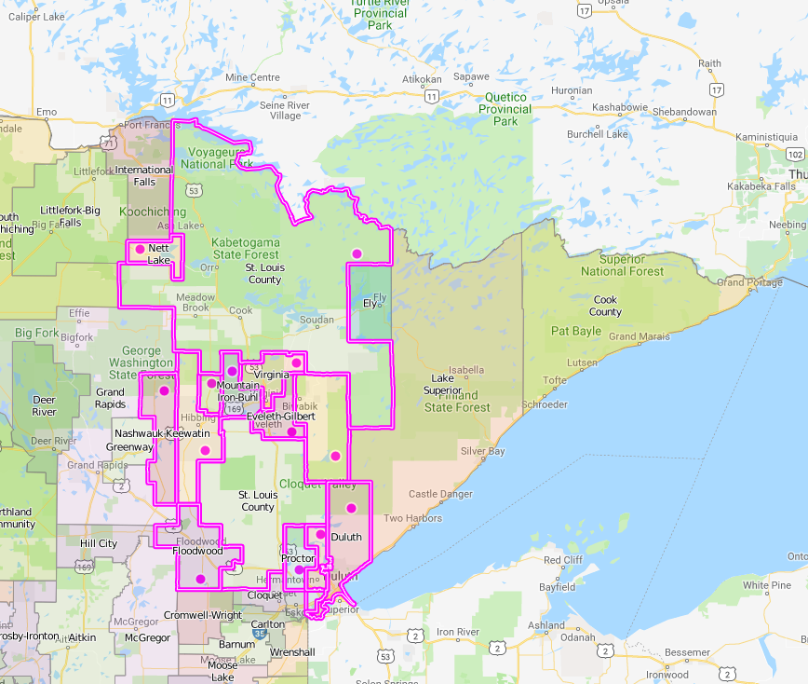
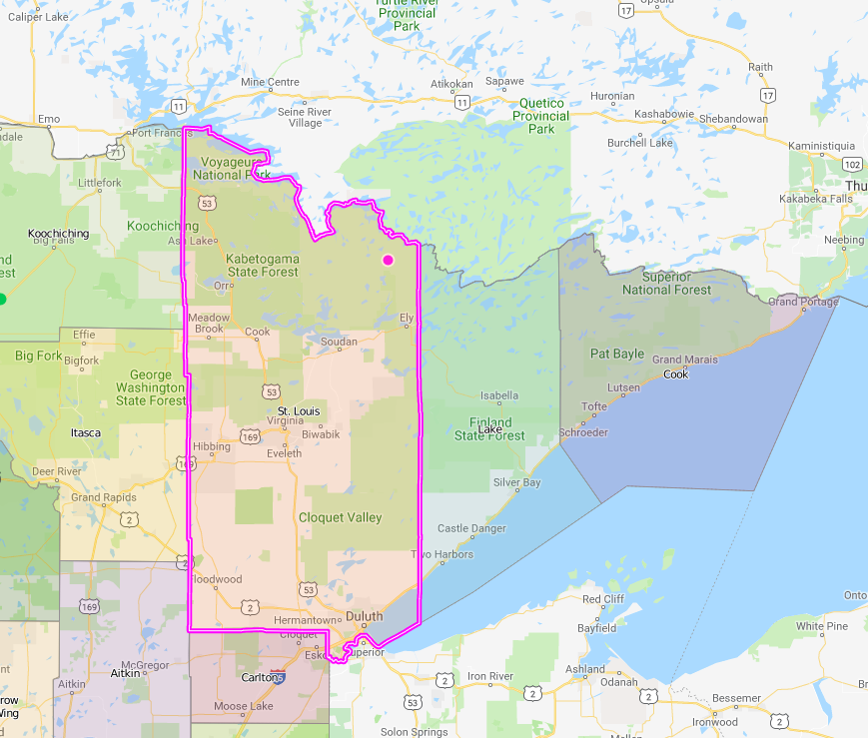
Adventure #2
St. Louis County
Compare
Counties &
School Districts
School districts within
St. Louis County
@MNCompass

Slide 70
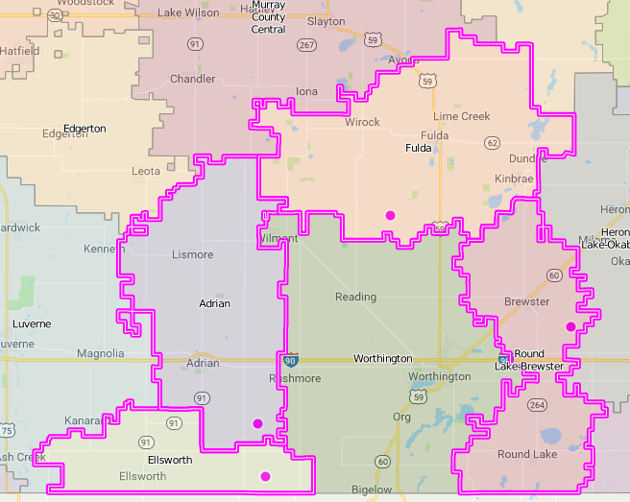
Adventure #2
Build & Compare
Worthington School District
and surrounding School Districts
Surrounding School Districts
(Ellsworth, Adrian, Fulda, Round Lake Brewster):
8% Of Color; 2% Foreign-born
Worthington School District:
50% Of Color; 26% Foreign-born
Notes:
with more than one geography (Our changing communities may be different from our neighboring communities)
Using the mapping tool, you can see how demographic changes are occurring in other school districts as well, but the are in line with that of greater Minnesota as a whole. Worthington school district is experiencing greater demographic change than other school districts in the same area.
https://www.mncompass.org/profiles/custom/custom-profile?report_id=5e08dfb2d16ae474b0842b02f36224f0

Slide 71
Choose your own data adventure
Using the Build your own data tool
#3 Draw a Profile
@MNCompass
Notes:
List the four examples that we included in the Insight article
Highlight examples using United Way service areas
Share specific data points about each area to highlight different data options

Slide 72
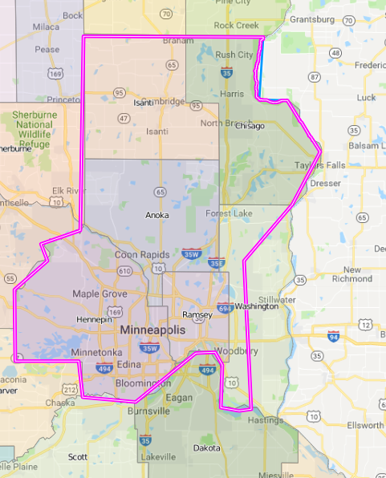
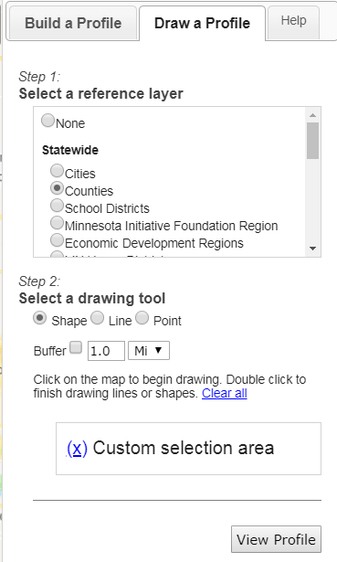
Adventure #3
Draw profiles
Greater Twin Cities United Way Service Area
@MNCompass
Notes:
Saw a lot of alignment in terms of feedback we heard from the listening sessions and in the Bush evaluation; folks are interested in using this tool for reasons currently use MN Compass—but now able to do so

Slide 73
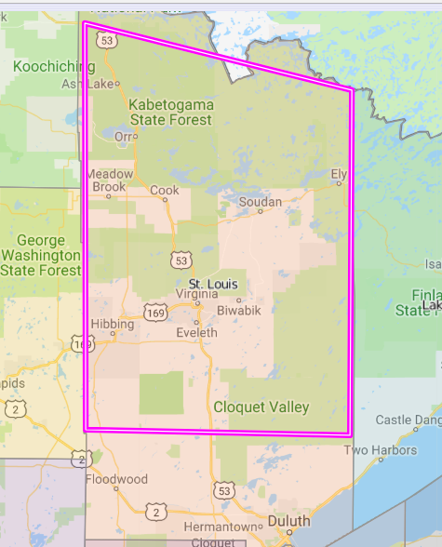
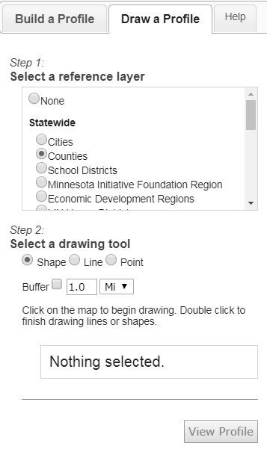
Adventure #3
Draw profiles
Northern & Southern
St. Louis County
“Being able to customize the data, with our without the city of Duluth”
@MNCompass
Notes:
Saw a lot of alignment in terms of feedback we heard from the listening sessions and in the Bush evaluation; folks are interested in using this tool for reasons currently use MN Compass—but now able to do so

Slide 74
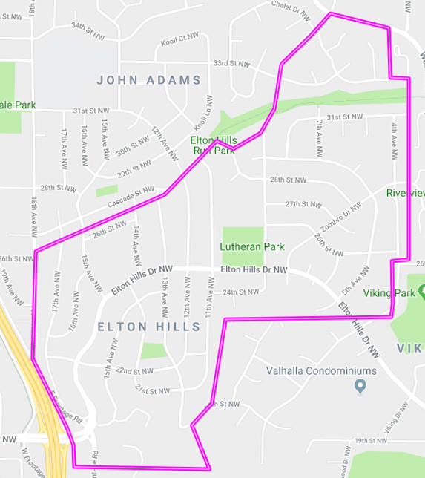
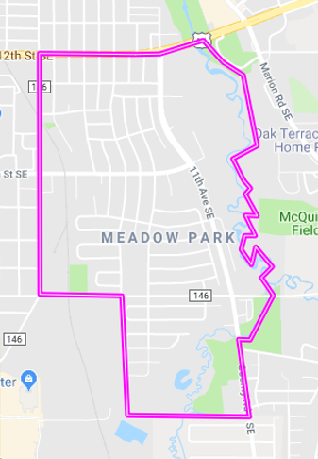
Adventure #3
Draw profiles
Neighborhoods for your city
Owner-occupied housing:
72%
Elton Hills Neighborhood, Rochester
93%
Meadow Park Neighborhood, Rochester
@MNCompass
Notes:
Elton Hills—11% 65+
Meadow Park—18% 65+

Slide 75
How are people using the BYO statewide tool?
@MNCompass
Notes:
MDH Equity Analysis at Zip Code Level
MNDOT—Drawing their districts at state level
Minnesota Community Education
United Way Service Areas—ask Ann if we can highlight

Slide 76
Continuing to work with communities across the state
Minnesota Compass Champions
Regional trend presentations, workshops, & webinars
More Greater Minnesota
research
Greater Minnesota Advisory
Council

Slide 77








Thank You!

