Slide 1
Partnering with an Accessibility Testing Vendor
Madhulika Gaur | Business and Quality Analysis Supervisor
Duy Nguyen | Accessibility Quality Analyst

Slide 2
People with Disabilities
One in 4 U.S. adults – 61 million Americans*
Disabled status can change for people
Four major categories of disabilities
*Data from CDC.gov

Slide 3
Four Disability Categories
Cognitive
Vision
Physical
Auditory

Slide 4
Minnesota Accessibility Standards
Which guidelines and standards do we follow?
Section 508 standards
Applies to technology created by the federal government
Web Content Accessibility Guidelines (WCAG)
Guidelines published by the Web Accessibility Initiative (WAI)
Web-based content
MMB currently follows WCAG 2.0 Level A/AA

Slide 5
Importance of the Standard
Improve the accessibility and usability of information technology products and services for all State of Minnesota government end-users.

Slide 6
Accessibility Testing – Definition
Testing that is performed by trained specialists who will use WCAG 2.0 levels A and AA and the Federal Electronic and Information Technology Accessibility Standards of Section 508 of the Rehabilitation act of 1973, and other guidelines as a framework for testing and making recommendations for design/remediation.
https://mn.gov/mnit/government/policies/accessibility/

Slide 7
WCAG Compliance Level Examples
Level A
1.1.1 – Non-text Content
Provide text alternatives for non-text content.
Level AA
2.4.6 – Headings and Labels
Headings and labels describe topic or purpose.
Level AAA
3.1.3 – Unusual Words
A mechanism is available for identifying specific definitions of words or phrases used in an unusual or restricted way.

Slide 8
Testing Types
Manual Keyboard Testing
Screen Readers
JAWS 18 with Internet Explorer
NVDA with Firefox
Automated Tools
WAVE with Chrome
aXe with Chrome
Color Contrast
WebAIM Contrast Checker
Color Contrast Analyzer
Magnification
Windows Magnifier

Slide 9
Identifying the Need for an Accessibility Vendor
Underlying project:
Peoplesoft Financial Management System (FMS) and Supply Chain Management (SCM) suite of modules are collectively known as StateWide Integrated Financial Tool (SWIFT).
SWIFT, which was developed in the Oracle Peoplesoft platform, needed to be upgraded from versions 9.1 to 9.2.
Oracle support for the previous version was expiring.
Challenges to address:
People Tools 8.55 does not meet all the necessary WCAG2.0 (Level AA) and Section 508 accessibility standards
Needed to manage these accessibility standards and ensure that deficiencies are properly documented and a workaround plan is in place.
State does not have enough trained staff to properly conduct accessibility testing within given timeframe.

Slide 10
Accessibility Testing for SWIFT 9.2 Upgrade
Planning phase started after project initiation.
General scope of work was developed along with a list of deliverables.
Accessibility testing was also addressed at that time.
Accessibility was an important element to the success of the SWIFT project.
Accessibility testing need was identified while developing detailed project plan to ensure that the system meets accessibility standards.

Slide 11
Project Development and Testing Standards
System development and testing using WCAG 2.0 standards (level AA) and Section 508 subparts A-D.
People tools 8.57 (SWIFT) may not fully meet these standards, MNIT partnering with MMB QA team will have to work with Oracle to ensure compliance.
Development support standards:
Customizations will be reviewed to meet accessibility standards.
Oracle may be responsible for providing accessibility fixes that do not meet standards.

Slide 12
Vendor Selection Process
Decision was made to find an accessibility vendor.
Accessibility requirements were added in the RFP after initial accessibility planning.
Solicitation:
Scope of work included that deliverables must be accessible, what specifically needs to be accessible, and what will become part of the contract.
Accessibility vendors evaluation included testing of the Oracle applications, sample electronic documents, etc.

Slide 13
Contractual Agreement
Original contract terms identified the entire system as an accessible deliverable
Scope was reduced due to deadlines
Decisions:
A third-party vendor planned to conduct accessibility testing in partnership with the MNIT partnering with MMB accessibility QA team.
MNIT partnering with MMB project team will give application demo to vendor for understanding.

Slide 14
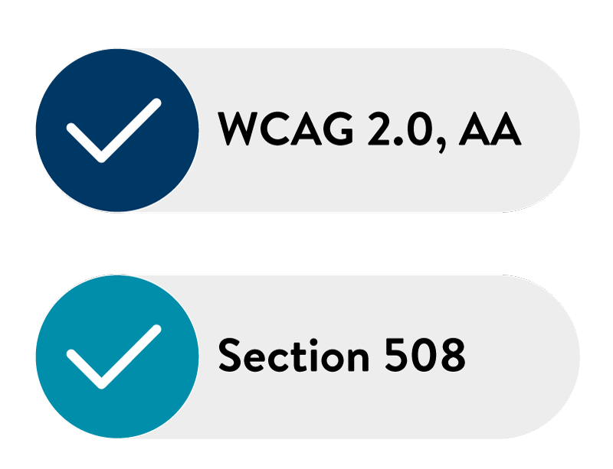
Test Scenarios and Defect Documentation
Accessibility vendor will create test scenarios as per WCAG 2.0, AA and Section 508 standards. Execute test cases, report test results and defects.
Accessibility vendor will provide recommendations for identified defects, provide a final test results document that gives holistic view of all defects and overall test coverage.

Slide 15
Why We Chose This Vendor
Vendor was fully qualified to perform user interface accessibility testing tasks:
They meet the State’s accessibility standards for each identified state system within given the timeline.
The project team interviewed the vendor through phone conversations.
Vendor was selected based on evaluation done by internal scoring team.
Vendor agreed to perform all duties and responsibilities for accessibility testing of the SWIFT and HUB systems.

Slide 16
Post-Contract Kick-Off Meeting
Building a relationship
Discuss test plan
Defect management
Project team received access to vendor-developed defect and reporting portal
Agreed upon weekly meeting to maintain clear understanding of testing status throughout the project

Slide 17
QA Team Introduction
Scheduled a WebEx conference call.
Introduced MNIT partnering with MMB QA team with Vendor QA testing team.
Discussed accessibility testing approach of Vendor QA team.
Vendor has actual accessibility users as QA testers.
Non-accessibility users partner with them for testing, issue discussion and defect documentation.
Discussed accessibility testing progress to-date and frequently observed issues.

Slide 18
Test Plan
The Test Plan described the scope, entry/exit criteria, and other activities.
“Living” document that is constantly changing throughout the project.
Outlines what will be tested, how testing is performed, and the test execution schedule.

Slide 19
Test Approach
Vendor to execute initial accessibility testing (audit) – baseline testing
Testing will follow a standard set of scenarios and scripts
Issues identified will be captured via vendor tracking tool (web-based applications)
MNIT partnering with MMB QA Team will have access to view, manage and export those issues into MTK (Methodology Tool Kit)
Issue prioritization and management process will be followed (MNIT partnering with MMB QA Team to manage)

Slide 20
Testing Scope
Scope breakdown
SWIFT Supplier Portal – 31 Components
HUB – 20 Components
Functionality including navigation, personalization, administration (user and password maintenance) and news publications.
SWIFT – 157 Components
Overall component count was for tile/navigation collection components.

Slide 21
Vendor Setup Process
Define the vendor’s roles and responsibilities.
Create test scenarios per WCAG 2.0 and section 508 standards.
Execute test scripts, complete live-user accessibility audit.
Provide audit report(s) which includes results per sprint (new sprint each week).
Provide technical support during remediation (as described in the contract) and clarity on defects.
Provide training to state accessibility QA team.

Slide 22
MNIT Project Team Setup Process
Define our team’s roles and responsibilities.
Provide test environment, coordinate system access, and resolve firewall issues.
Day to day engagement of the vendor and conduct touch points.
Demonstrate operations of the system.
Provide prioritized list of business process, modules, and components.
Provide test plan and test data.

Slide 23
MNIT Project Team Issue Management Process
Monitor vendor issue tracking tool.
Transfer issue into MTK and update MTK throughout the regression testing process.
Open Oracle SRs for issues and provide appropriate documentation.
Retest issues submitted to Oracle in demo.
Work with designated developers on issues that need to be resolved.
Escalate concerns.

Slide 24
Vendor Testing Coverage
Vendor testing (audit) to cover mobile devices, tablets, and desktops
Variety of automated tools and browsers such as IE with JAWS, Firefox with NVDA, ZoomText with Chrome, etc.
Manual testing such as keyboard only and color contrast

Slide 25
Accessibility Defect Management Process
Defect management process
Defect Creation, Create MTK, Create SR, Monitor Progress, Retest, Close SR/MTK
How we partnered with Business Analysts and development team
Level of severity for the Business Analysts to determine priority
Documenting WCAG violation
Suggested fixes
Other projects where we performed accessibility testing
Supplier, Fiscal Note Tracking System
Future projects - ELM, HCM

Slide 26
System Readiness
IP address – access granted to vendor
Environment Ready / Security Access – determined/coordinated
URL for accessing applications
Supplier portal (separate URL) ready
PeopleTools (PT) and PUM versions determined
Test IDs and test data

Slide 27
Partnering for Defect Management
How we partnered with Vendor QA team and MNIT development team?
Working together to help bridge gaps and improving processes, products, services and software. Developing a more efficient project delivery process.
Engaging to expand efficiencies and adding value.
Establishing relationships ,sharing ideas and working towards common goals.
Discovery
Resolution
Verification
Closure
Reporting
Categorization

Slide 28
Accessibility Testing Defect Management Process
Discover: As many defects as possible before the customer does.
Categorization: Priority (critical, high, medium, low).
Resolution: Assign to a developer, create an Oracle service request, schedule a fix, fix the defect, and report resolution from developers when defects are fixed.
Verification: Verifying in multiple environments to ensure the fix was migrated successfully.
Closure: Once defect is resolved and verified, the defect status is closed.
Reporting: The status and progress throughout the project to upper management.

Slide 29
Reporting Severity
Vendor portal had the capability to report issue status with the following criteria:
Pending
Open
Complete, Partially Complete
Unable to Reproduce
Not Fixed , Not Fixing
Not Applicable
MTK issue severity was reported with the following criteria:
Critical
Serious
Warning

Slide 30
Challenges
Access through the firewall
Using the same tools and versions as the vendors
Assigning severity and priority to the defects

Slide 31
Lessons Learned
Accessibility testing cannot be rushed
Anyone should be able to understand and replicate the defect
Changes to our testing process:
Importance of performing thorough testing
Detailed defect logs

Slide 32
Testing Sign Off
All designated scope (208 components) tested by the Vendor
Vendor report-out must articulate that all scope (per contract) was tested
Ensured that all issues were logged with Vendor tracking tool
MNIT partnering with MMB QA team followed up on all issue to ensure understanding and ownership
Technical training of digital accessibility for state team

Slide 33
Technical Training
Knowledge transition for MNIT partnering with MMB QA team.
Vendor's accessibility team came to the Minnesota State IT office
1st session: General accessibility overview
2nd session: Vendor discussed their testing process, determining fixes, and testing tools.

Slide 34
Payment Check Released
Payment was released to the vendor after the MNIT partnering with MMB QA team confirmed that all deliverables were met including training.

Slide 35
Questions? Contact us!
Madhulika Gaur madhulika.gaur@state.mn.us
Duy Nguyen duy.nguyen@state.mn.us
Minnesota’s Office of Accessibility
MNITAccessibility@state.mn.us

