Slide 1
Charlie Meier (CSM)
2019Nov.27

Slide 2
Agenda
Why should you care about Agile?
Why Agile?
History - How did we get here
Common Agile Methods
Focus on Scrum
How to set Agile up for success
Common myths
How to learn more

Slide 3
Why should you care about Agile?
Be Informed
Ex: “You’re lucky you brought your car in when you did… your blinker fluid was almost COMPLETELY DRY!!!”
Water

Slide 4
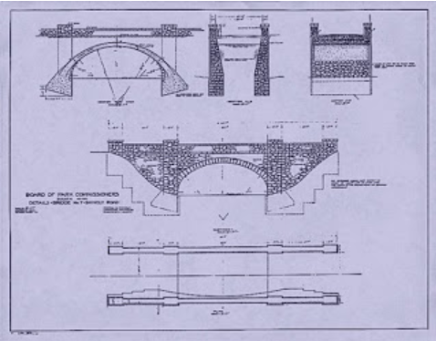
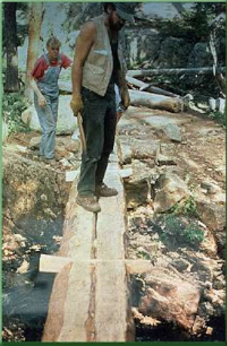
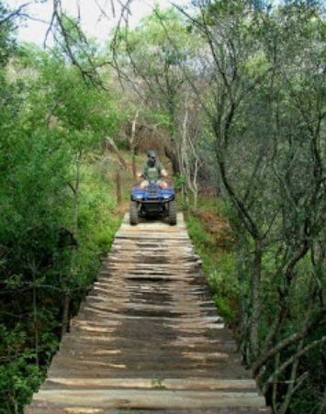
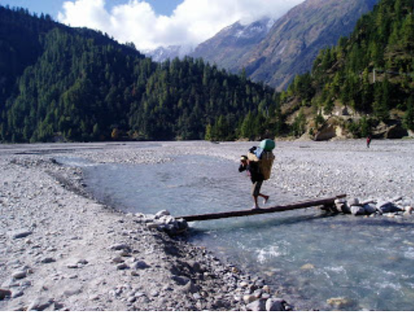
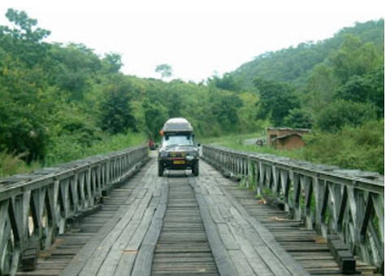
Why should you care about Agile?
Different way to deliver something of value quickly
Ex: “Crossing a river”
Notes:
https://www.caroli.org/en/agile-bridge-analogy/
Credit to Paulo Caroli

Slide 5
What should you remember today?
Why Agile?
What lead to Agile?
When to use?
Scrum Basics
Where/how to learn more?

Slide 6
Why Agile?
Time to Market
Repeatedly delivering value (all along)
Iterative Approach / Incremental improvements
Fail (and learn) Quickly
Predictable velocity
Flexibility
Notes:
All about delivering something of value quickly (i.e. thin slicing & delivering A, B, C, D, E,)

Slide 7
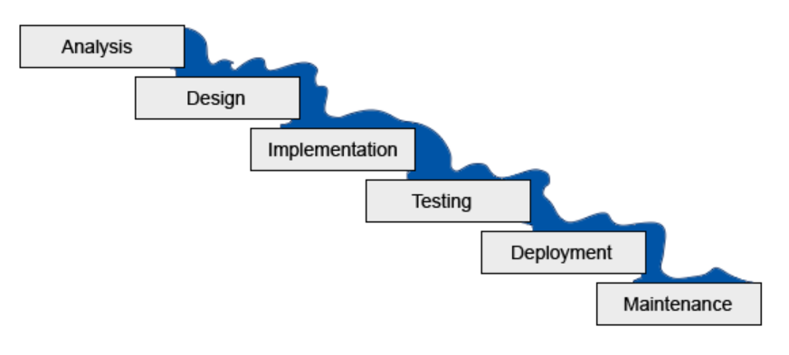
What lead to Agile?
Waterfall Project Methodology
+6-9 months
Notes:
Image Credit: http://www.agile-scrum-master-training.com/
1956 - Herbert D. Benington at the Symposium on Advanced Programming Methods for Digital Computers on 29 June 1956.^{[2]} This presentation was about the development of software for SAGE.
https://ieeexplore.ieee.org/xpl/tocresult.jsp?isnumber=4640764 (reprint from 1983)
1970 first formal description of the waterfall model is often cited as a 1970 article by Winston W. Royce,^{[3][4]} although Royce did not use the term waterfall in that article. Royce presented this model as an example of a flawed, non-working model; which is how the term is generally used in writing about software development—to describe a critical view of a commonly used software development practice.^{[5]}
1976 Paper by T.E. Bell & T.A. Thayer “SOFTWARE REQUIREMENTS: ARE THEY REALLY A PROBLEM? ”
https://static.aminer.org/pdf/PDF/000/361/405/software_requirements_are_they_really_a_problem.pdf
1985 US Dept. of Defense captured waterfall approach w/in “in DOD-STD-2167”
standards for working with software development contractors, which stated that "the contractor shall implement a software development cycle that includes the following six phases: Preliminary Design, Detailed Design, Coding and Unit Testing, Integration, and Testing".^{[7]}
1988 “in DOD-STD-2167” is refined to become “in DOD-STD-2167A,” refining software …
where the previous revision prescribed pages of design and coding standards, this revision only gave one page of general requirements for the contractor's coding standards; while DOD-STD-2167 listed 11 quality factors to be addressed for each software component in the SRS, DOD-STD-2167A only tasked the contractor to address relevant quality factors in the SRS.^{[3]} Like DOD-STD-2167, it was designed to be used with DOD-STD-2168, "Defense System Software Quality Program".
https://en.wikipedia.org/wiki/DOD-STD-2167A
Waterfall is GREAT where / when all variables are known and are unlikely to shift, i.e. where certainty is high & all req. can be gathered up front
Waterfall becomes increasingly cumbersome as uncertainty increases
Drawbacks:
Each phase should be completed before the next phase begins
Sign off required between each phase
Results from phase 1 “thrown over the wall” to team handling phase 2, etc…
Analysis -> Deployment can easily be +6-9 months or more – i.e. a LONG time to work on a product w/o any customer imput
When a mistake is made that mistake gets more expensive the further time has passed (50x more expensive if caught in Testing vs. in Analysis). THEN The mistake needs a “change order” & approved through a CAB (change advisory board)….

Slide 8
There has to be a better way!
1990s ushered in many lightweight “agile” methodologies
1991 RAD (Rapid App. Dev.)
1994 UP (Unified Process) & DSDM (Dynamic Systems Dev. Method)
1995 SCRUM
1996 Crystal Clear & XP (Extreme Programming)
1997 FDD (Feature Driven Development)

Slide 9
There has to be a better way!
2001 Feb. 11-13 Snowbird Ski Resort, Utah
17 “lightweight” process methodology pioneers
Agile Manifesto
Agile Values
Agile Principles

Slide 10
Agile Manifesto
“We are uncovering better ways of developing
software by doing it and helping others do it.
Through this work we have come to value:
Agile Values:
Individuals and Interactions over Processes and Tools
Working software over Comprehensive Documentation
Customer Collaboration over Contract Negotiation
Responding to Change over Following a Plan
That is, while there is value in the items on the right, we value the items on the left more.”
Source: https://agilemanifesto.org/

Slide 11
Agile Manifesto: 12 Principles
Our highest priority is to satisfy the customer through early and continuous delivery of valuable software.
Welcome changing requirements, even late in development. Agile processes harness change for the customer's competitive advantage.
Deliver working software frequently, from a couple of weeks to a couple of months, with a preference to the shorter timescale.
Business people and developers must work together daily throughout the project.
Build projects around motivated individuals. Give them the environment and support they need, and trust them to get the job done.
The most efficient and effective method of conveying information to and within a development team is face-to-face conversation.
Source: https://agilemanifesto.org/

Slide 12
Agile Manifesto: 12 Principles
7. Working software is the primary measure of progress.
8. Agile processes promote sustainable development. The sponsors, developers, and users should be able to maintain a constant pace indefinitely.
9. Continuous attention to technical excellence and good design enhances agility.
10. Simplicity--the art of maximizing the amount of work not done--is essential.
11. The best architectures, requirements, and designs emerge from self-organizing teams.
12. At regular intervals, the team reflects on how to become more effective, then tunes and adjusts its behavior accordingly.
Source: https://agilemanifesto.org/

Slide 13
Agile Methodologies
SAFe
Notes:
Image Credit: https://luis-goncalves.com/what-is-agile-methodology/

Slide 14
Focus on Scrum
Why?
+50% of all Agile projects use Scrum
Great (structured) place to start

Slide 15
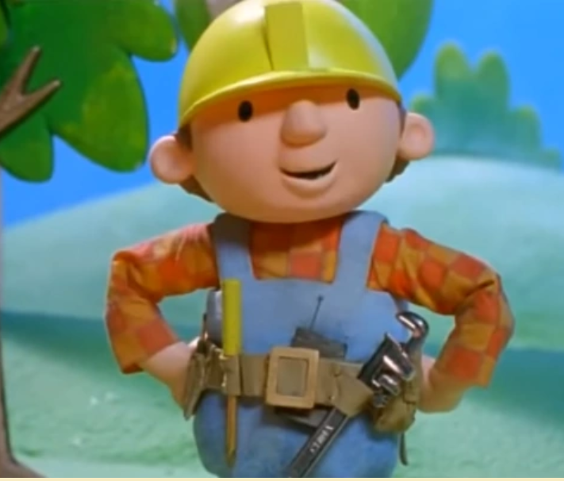
Scrum Roles
Product Owner: Speaks for the trees
Scrum Master
Protects the team
Team Members “Developers”
Creates & Delivers

Slide 16
Scrum Ceremonies
Sprint Planning: 1 hr. per wk avg. (of sprint duration)
Daily Scrum: 15 min. “standup”
Sprint Review (Demo): Review (sprint) delivered product
Sprint Retrospective: Reflect on sprint

Slide 17
Sprint Planning

Slide 18
Story Sizing
https://www.slideshare.net/LeapfrogTechnology/estimation-and-release-planning-in-scrum

Slide 19
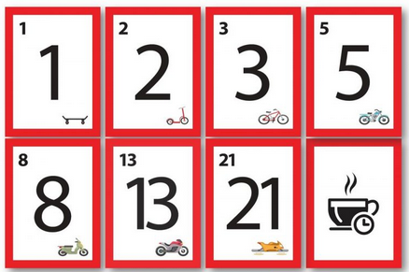
Story Sizing – Planning Poker
Credit: https://www.techagilist.com/agile/scrum/planning-poker-agile-estimation-method/

Slide 20
Daily Scrum

Slide 21
Sprint Review (Demo)

Slide 22
Sprint Retrospective – from this sprint…
What went well?
What could we improve?
Ref: https://www.myagilepartner.com/blog/index.php/2019/02/15/art-of-retrospective/

Slide 23
We tried baseball… it didn’t work
“The fanatical proponents of baseball tell us that it is a very exciting game, fun to play and fun to watch. They are clearly either stupid or evil or both, because we tried baseball and it didn’t work.”
“First of all, the requirements for the game are stupid: it does not scale. They say you need at least nine players on a side. That’s stupidly inefficient. The minimum number of players is clearly four: three men on and one batting. That’s how we played: four people on a side.”
Source: https://ronjeffries.com/xprog/articles/jatbaseball/

Slide 24
How to set up teams for success?
Leadership High Trust
Stick to the Agile Values & Principles
Self forming teams
“I don’t know”

Slide 25
Benefits of Agile Approach
Speed to Market
Increased learning loop “Fail Fast”
ALL IN “Business + Tech = Team
Engagement
Accountability

Slide 26
Common Myths
Agile is a faster way to complete the same work
Cheaper way to achieve the same work
Agile means no…
Accountability
Meetings
Documentation
We can pick & choose best parts of different methods

Slide 27
Want to learn more?
Resources:
https://agilemanifesto.org/
https://www.agilealliance.org/
https://www.scrumalliance.org/
MSLP Local:
https://www.agiledaytwincities.com/
https://www.meetup.com/AGILE-TWIN-CITIES/
Agility IRL https://www.agilityirl.com/
CPrime (formerly DevJam): https://www.cprime.com/product-agility/

Slide 28
https://englishlive.ef.com/blog/language-lab/question-words/

