Slide 1
Zero Trust, CARTA, CSF, CJIS, RMF
- OMG, how can I address all of these?
A Cybersecurity Best Practices Approach
Government IT Symposium
Peter Romness
Cybersecurity Solutions Lead – US Public Sector CTO Office
December 2019

Slide 2
Attack landscape constantly evolving
Advanced Persistent Threats
Supply chain attacks
Ransomware
Unpatched Software
Data/IP Theft
Spyware/Malware
Malvertising
Wiper Attacks
Drive by Downloads
Phishing
Rogue Software
Man in the Middle
Botnets
DDoS
Credential compromise
Cryptomining
Notes:
Attacks continuously become more sophisticated.
As reflected on the slide we’ll always see continued innovation from attackers.
Why? 6 trillion reasons why. Cybercrime is lucrative - estimated at $6T, so the problem isn’t going away - and we have to get better as an industry at helping.
For context, Gartner says global IT spend in 2018 will be $3.7 trillion, paling by comparison.

Slide 3
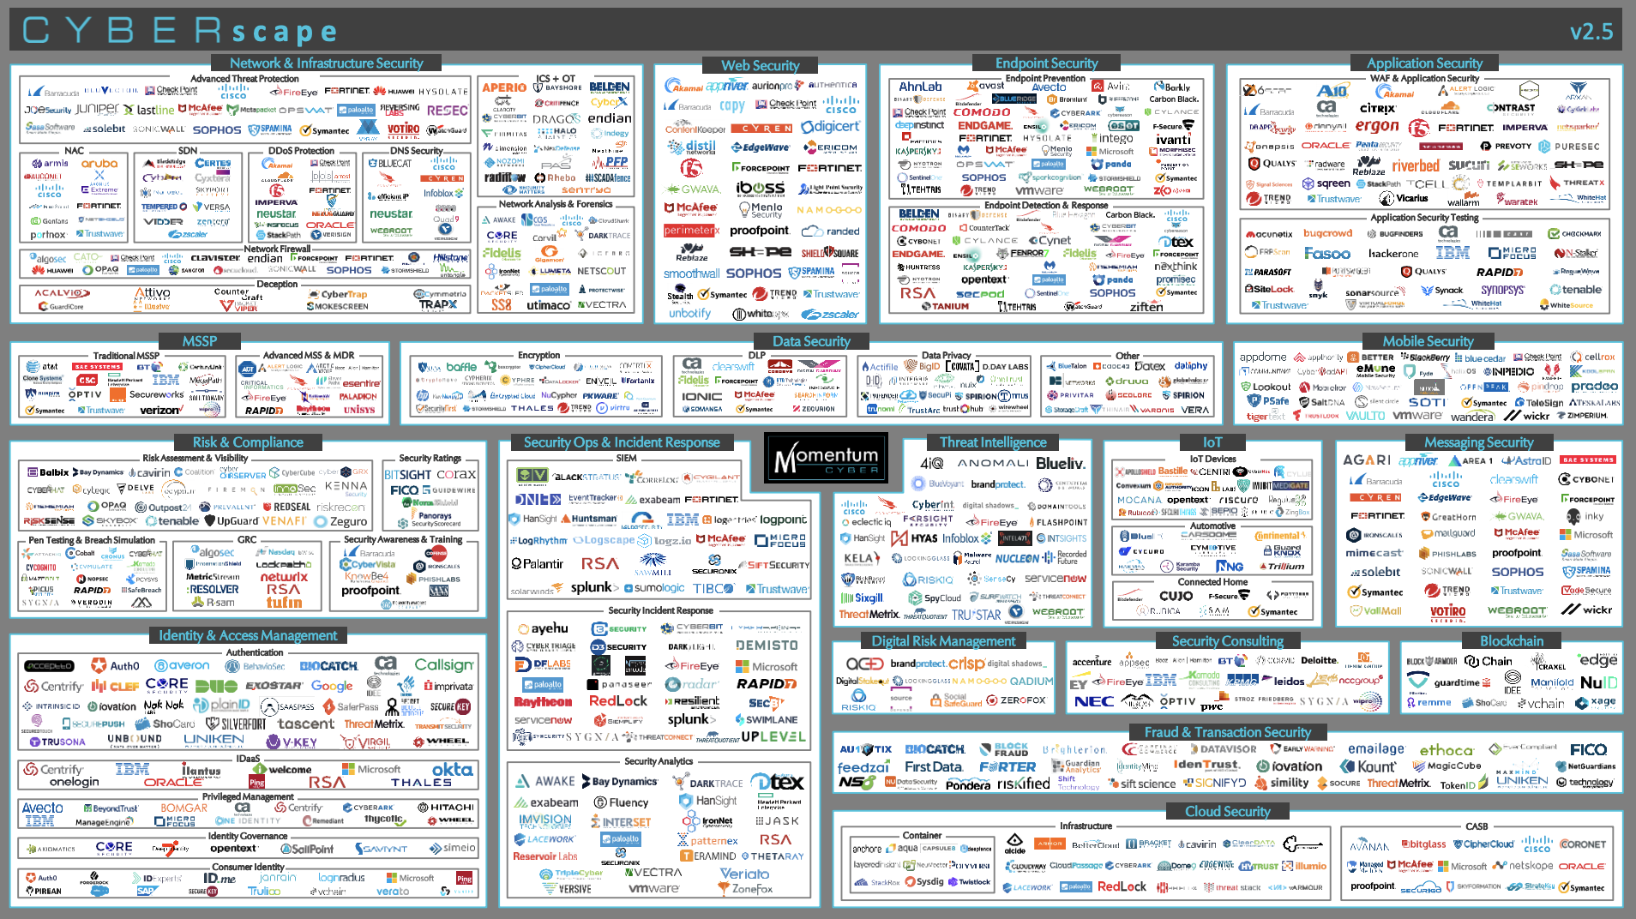
Impossibly complex
Notes:
Things can seem overwhelming when we think about responding to threats.
We often introduce new products and vendors to the security stack – whether or not we have the resources to manage them.
…And consider that there were more than 600 vendors at the RSA Conference….
This is why Forrester Research says that complexity is our #1 security challenge
Further exacerbating this, is the staff shortfall….ISACA estimates there will be 2 million unfilled jobs in infosec through 2019.

Slide 4
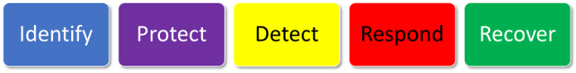
Approaches and Frameworks
Zero Trust
1
2
3
4
5
Data
What are these?
Why are we hearing about them?
How can I address them?
Securely identify
the device
Securely identify the user
Remove trust from the network
Externalise apps and workflows
Implement inventory-based access control
OMG
BeyondCorp
Devices
People
Network
Workloads
NIST Cybersecurity Framework
Visibility & analytics
Automation & orchestration
NIST SP 800-137
FIPS 199 & NIST SP 800-60
NIST Risk Management Framework
Monitor
Start
Categorize
NIST SP 800-37
6
1
FIPS 200 & NIST SP 800-53
Authorize
5
2
Select
NIST SP 800-53A
NIST SP 800-160
3
CJIS
CDM
Assess
4
Implement
CARTA

Slide 5
Let’s go from Overwhelmed to Empowered
If you have a
scalable, open and automated foundation,
you can address all Approaches and Frameworks

Slide 6
The NIST Risk Management Framework (RMF)
NIST RMF is a process flow and more detailed reference then CSF
What: A more prescriptive Risk Management Process.
Goal: Describes more detailed “Outcomes” then CSF. It is a great reference
Process: Uses NIST 800 series Special Publications for each part of the risk management cycle
Business drivers: Still flexible, still recommendations – but more detail to drive decisions
Adaptable to: All environments
FIPS 199 & NIST SP 800-60
NIST SP 800-137
Monitor
Start
Categorize
6
1
FIPS 200 & NIST SP 800-53
NIST SP 800-37
It’s still FLEXIBLE…
But is kind of a Checklist
Authorize
5
2
Select
NIST SP 800-53A
NIST SP 800-160
Assess
4
3
Implement
Source: NIST RMF Overview, http://csrc.nist.gov/groups/SMA/fisma/framework.html
Notes:
For boardroom and C-Suite
To guide investments

Slide 7
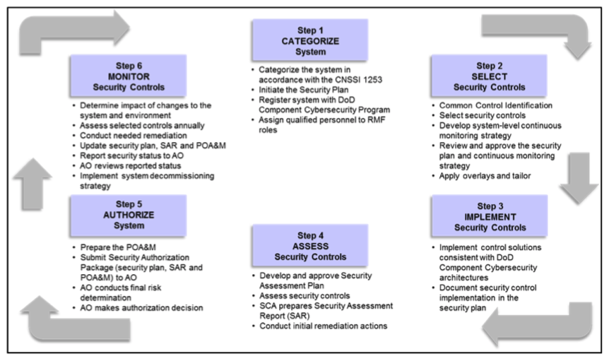
DoD RMF
Driving the Department of Defense to risk based threat management
What: A DoD implementation of NIST RMF
Goal: Establish and use of an integrated enterprise-wide decision structure for cybersecurity risk management. Move the DoD from STIG to Risk Management
Process: References NIST 800 series Special Publications for the DoD specific environment
Encourages: Reciprocal acceptance of DoD and other federal agency authorizations
Included in: All acquisition processes
DoD Goal: Less checklist…
More risk based decisions
Notes:
STIG - Security Technical Implementation Guide

Slide 8
The NIST CyberSecurity Framework
NIST CSF enables more effective management of risk
What: Prioritized, flexible, repeatable, performance-based, cost-effective approach – becoming a de-facto standard
Goal: A common language to identify, assess and manage cyber risks
Business drivers: guide cyber resources and activities to help manage risk
3 parts: Framework Core/ 4 Maturity Tiers / Your Profile
  Core alignment with business requirements, risk tolerance and organizational resources
Adaptable to IT / IoT / ICS / CPS
It’s FLEXIBLE…
and it’s NOT a Checklist!!!
The Core
Notes:
For boardroom and C-Suite
To guide investments

Slide 9
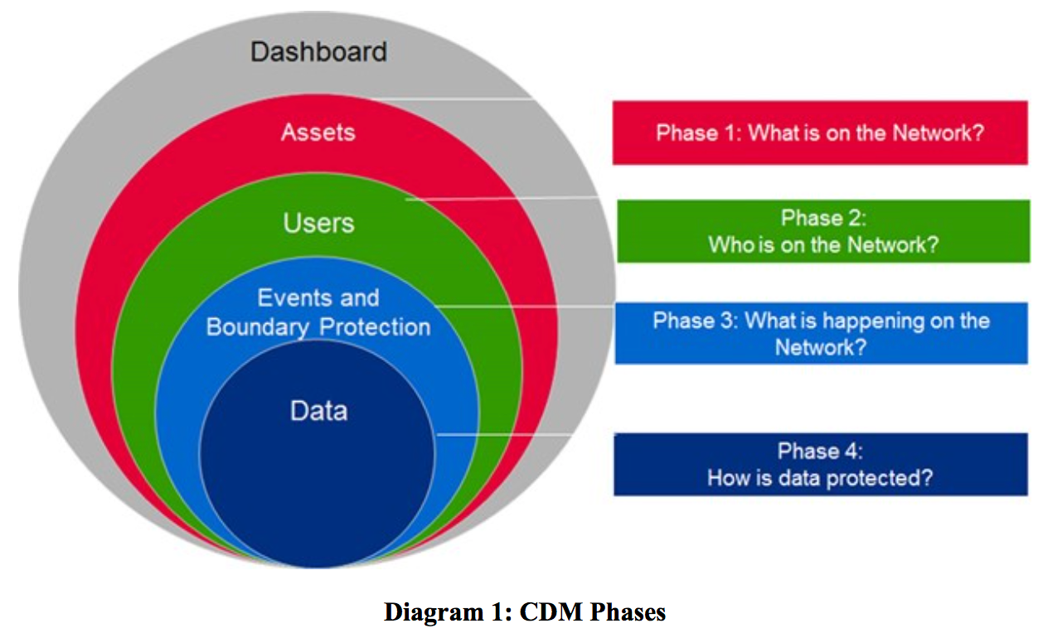
Continuous Diagnostics & Mitigation (CDM)
Federal requirement for Federal Civilian Agencies
What: Federal mandate to protect and continuously monitor civilian sector
federal departments and agencies
Who: Managed by DHS – Administered by GSA - Enforced by OMB
Goal: Threat protection and continuous reporting of Assets, Users, Data, Events
Process: Required hierarchal dashboard
Department→Agency→OMB
Mandate: Holds agency heads responsible
with report cards and budget withholding
compliance
Federal Requirement…
Mostly about compliance and reporting
Notes:
For boardroom and C-Suite
To guide investments

Slide 10
Criminal Justice Information System (CJIS)
FBI Requirement to connect to the CJIS database
What: Requires compliance to access CJIS Data
Who: Every law enforcement agency in the nation who uses FBI criminal justice information to reduce and stop crime
Audits: Audits occur every three years, and non-compliance has serious ramifications – including potential loss of access to
FBI CJIS systems
Based on: NIST RMF particularly NIST SP800-53
compliance
FBI Requirement…
Completely about compliance
Notes:
For boardroom and C-Suite
To guide investments

Slide 11

A little bit of Zero Trust history
Jericho Forum
ZT
BeyondCorp
CARTA & ZTX
ZTA
2004
2010
2014
2017
Today
TODAY
De-perimiterization
An international group of corporate CISOs and vendors (Cisco hosted initial meeting)
Focused on solving “de-perimiterization” problem
Early output calling for “the need for trust”
Multiple Models Emerge
Forrester coined Zero Trust.
Google published their ZT solution as BeyondCorp
Forrester then expands to Zero Trust eXtended
Gartner names their model Continuous Adaptive Risk and Trust Assessment
Generalized
The industry has largely accepted Zero Trust Architecture as the general term

Slide 12
Zero Trust
Popularized by Forrester - ZT and ZTX
What: A security strategy based on “least-privilege” to address the modern “perimeter-less” IT environment
Intent: Assumes all environments are hostile - no access until proven trusted
Tenants: All users, devices, applications, data, and network flows encrypted, authenticated and authorized
Enablement: Visibility and automation systems are what allow a zero trust network to be built and operated
Adaptable to: All environments
Missing: Threats
Zero Trust
Zero Trust
Data
Devices
People
Network
Workloads
Devices
Automation
Analytics
Zero Trust is a strategy and design approach - not a checklist or a thing you buy
People
Network
Workloads
Visibility & analytics
Data
Automation & orchestration
Mission Focus

Slide 13

Zero Trust
Build upon 5 fundamental assertions
As an Architecture, Zero Trust implies innate distrust
(e.g. – ”default deny”)
  Every device, user, and network flow is authenticated and authorized
  Policies must be dynamic and calculated from as many sources of data as possible
  The network is always assumed to be hostile
  External and internal threats exist on the network at all times
  Network locality is not sufficient for deciding trust in a network
Zero Trust Cybersecurity Current Trends April 18, 2019
American Council for Technology-Industry Advisory Council (ACT-IAC)
ACT-IAC: www.actiac.org

Slide 14
Zero Trust
Benefits
A more secure architecture
A focus on safer data
Improved protection against existing and evolving threats
Reduced impact from breaches
Improved compliance and visibility
Potential cost reduction
Zero Trust Cybersecurity Current Trends April 18, 2019
American Council for Technology-Industry Advisory Council (ACT-IAC)
ACT-IAC: www.actiac.org

Slide 15
Zero Trust
ACT–IAC Conclusions
ZT Solutions are widely available in the market and currently in use in the private sector
Many companies are currently developing new capabilities and solutions to support ZT and there is healthy competition in the market
We observed that no single, holistic ZT solution is currently available from a single vendor
Acquiring a comprehensive solution would require integration of multiple vendors’ products and services
Many companies have have established strategic partnerships and agreements with other companies to offer more comprehensive, integrated, and interoperable solutions
Zero Trust Cybersecurity Current Trends April 18, 2019
American Council for Technology-Industry Advisory Council (ACT-IAC)
ACT-IAC: www.actiac.org

Slide 16
BeyondCorp
Google’s model implementation of Zero Trust
What: Cloud focused - models a high level guide to implementing their Zero Trust implementation
Intent: Shift access controls from the perimeter to individual devices and users
Process: Identify devices and users, remove trust, externalize apps and workflows, implement access control
Tenants: Perimeterless design, context aware, dynamic access controls
BeyondCorp is a Zero Trust example
- It can be used as a guide
1
2
3
4
5
Securely identify
the device
Securely identify the user
Remove trust from the network
Externalise apps and workflows
Implement inventory-based access control

Slide 17
CARTA - Continuous Adaptive Risk and Trust Assessment
Gartner’s more comprehensive response to Zero Trust
What: Similar to Zero Trust with more emphasis on Threat protection
Intent: Virtuous cycles for: Access Protection
Threat Protection
Implement → Operate/Monitor → Analyze → Adjust
Applies to: All users, systems, system activities,
payloads, networks
Enablement: Emphasizes continuous improvement
CARTA is a strategy and design approach - not a checklist or a thing you buy
Source: Gartner (May 2017)

Slide 18
Zero Trust
Key Considerations for your Zero Trust Environment
Zero Trust is not a bolt-on security product – must be designed into the network
No implicit trust
  Must authenticate before being allowed to connect to any asset on the network
  Assume all traffic, regardless of location, is a potential threat
Provide total visibility and analytics across the entire network
  Continuously monitor/inspect/log all traffic, assess threat and automate responses
  Detect and respond to anomalous activity in real-time
Ensure granular network segmentation by user, device and application
  Adopt a least-privileged strategy – only grant access to needed resources to perform their job
Shear volume makes automation critical – to manage access and respond to security threats
Open, extensible Foundational platform that works with existing investments
Optimize risk management through real-time response to dynamic threats

Slide 19
Security approach to confront risk
Continuously detecting threats and verifying trust
Dynamic Context
Continuous threat detection
Prevent attacks while continuously detecting and remediating the most advanced threats
Continuous trust verification
Continuously verify identity and device trust across the software-defined perimeter
Notes:
At the highest level, there are two key security aspects moving us towards empowerment:
Continuous threat detection and
Continuous trust verification
With good threat intelligence, we can prevent 99% of attacks.
…with the right identity verification, we prevent 99% of unauthorized access.
And to empower organizations to address the remaining 1% of risk
we must decrease time to detect and remediate threats
and monitor user trust when granting access across the Software Defined perimeter.

Slide 20
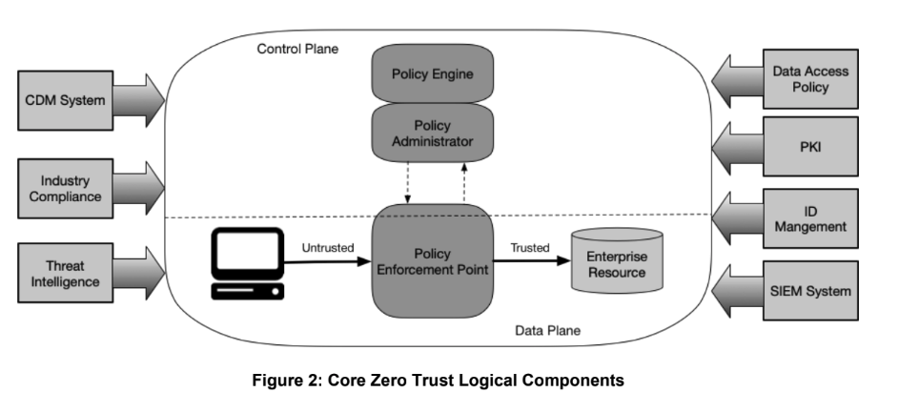
NIST Zero Trust Logical Components
From NIST SP 800-207 Draft
Identity Services Engine (ISE)
SD Access
(Network)
Tetration
(Data Center)

Slide 21
NIST Network Requirements to Support ZTA
Enterprise systems have basic network connectivity
The enterprise must be able to determine which systems are owned or managed by the enterprise and which devices are not owned or managed
The enterprise can capture all network traffic
Enterprise resources should not be discoverable without accessing a PEP
The Data Plane and Control Plane are logically separate
Enterprise systems can reach the PEP component
The PEP is the only component that can access the Policy Administrator and Policy Engine
Remote enterprise systems should be able to access enterprise resources without needing to traverse through enterprise infrastructure.
Enterprise systems may not be able to reach certain PEPs due to observable factors

Slide 22
Cisco Zero Trust approach addresses:
Trusted Workforce User and Device Access
Trusted Workplace IoT, Edge and Sensor Access
Trusted Workloads
App and Data Access
App request
Verify identity
Network request
Verify profile
Data
center
request
Baseline East-West traffic
Continuous verification
and detection
Continuous verification
and detection
Continuous verification
and detection
SDA
ETA Tetration
DUO
Umbrella
SD-WAN
ACI / ACI-A
NGFW
Secure access
ISE
Verify hygiene
Secure access
ISE
Tag East-
West traffic
Secure access
ISE
Verify app behavior
Stealthwatch
Stealthwatch
Stealthwatch
Enforce policy
Enforce policy
Generate whitelist
Cisco Talos…for Threat Intelligence and proactive threat defense
Cisco Zero Trust Recommandation:
  An open, scalable foundation supporting all Frameworks with multi-vendor tool integration
        Comprehensive, integrated, interoperability (i.e., SIEM, SOAR, MDM, Threat, SDA, etc.)
        Integrated threat defense
        Granular microsegmentation enforcement
Notes:
Security Information and Event Management / Security Orchestration, Automation and Response
Objective:
Agree that security & network teams don’t want their IT/OT, LoB or DC counterparts from acquiring 3 siloed solutions via different vendors.
Talking Points:
Only Cisco can establish trust for users & devices anywhere, IoT in campus & branches, and hybrid workloads in on-prem & multicloud infrastructure.
Only Cisco can secure access for app, network & DC requests with an automated adaptive policy.

Slide 23
Cisco Zero Trust Recommendations
Trusted Workforce User and Device Access
Trusted Workplace IoT, Edge and Sensor Access
Trusted Workloads
App and Data Access
App request
Verify identity
Network request
Verify profile
Data
center
request
Baseline East-West traffic
Continuous verification
and detection
Continuous verification
and detection
Continuous verification
and detection
Secure access
Verify hygiene
Secure access
Tag East-
West traffic
Secure access
Verify app behavior
Enforce policy
Enforce policy
Generate whitelist
Cisco Talos…for Threat Intelligence and proactive threat defense
  An open, scalable foundation supporting all Frameworks with multi-vendor tool integration
        Comprehensive, integrated, interoperability (i.e., SIEM, SOAR, MDM, Threat, SDA, etc.)
        Integrated threat defense
        Granular microsegmentation enforcement
Notes:
Security Information and Event Management / Security Orchestration, Automation and Response
Objective:
Agree that security & network teams don’t want their IT/OT, LoB or DC counterparts from acquiring 3 siloed solutions via different vendors.
Talking Points:
Only Cisco can establish trust for users & devices anywhere, IoT in campus & branches, and hybrid workloads in on-prem & multicloud infrastructure.
Only Cisco can secure access for app, network & DC requests with an automated adaptive policy.

Slide 24
Zero Trust
Developed by Forrester - ZT and ZTX
Zero Trust
Zero Trust
Data
Data
Identify
Identify
Devices
Devices
People
Network
People
Network
Workloads
Workloads
Interaction
Interaction
Visibility & Analytics
Visibility & Analytics
Automation & Orchestration
Automation & Orchestration
Zero Trust Platform
Zero Trust Platform
+ Duo
+ Tetration

Slide 25
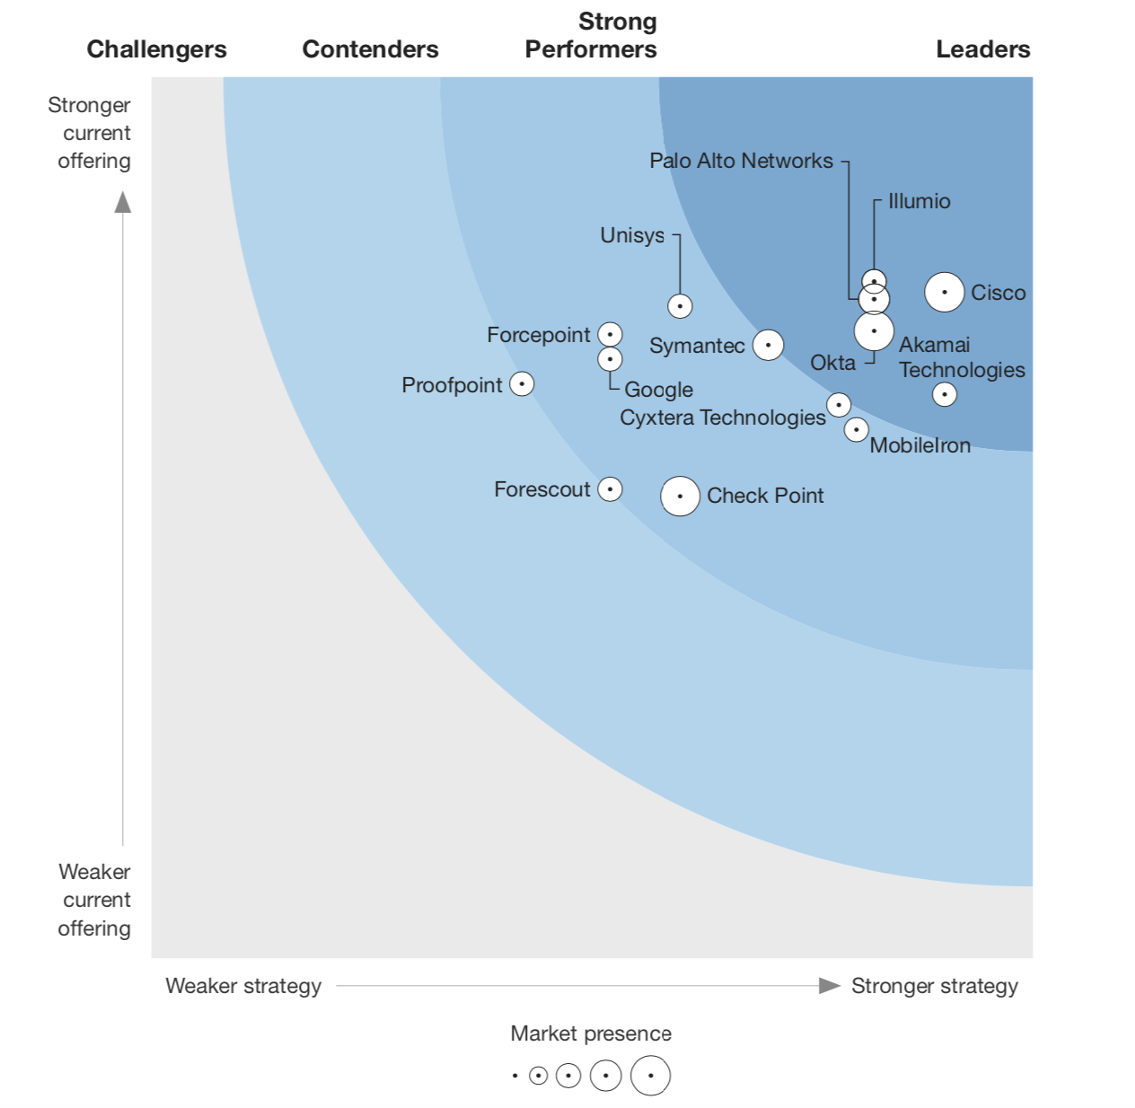
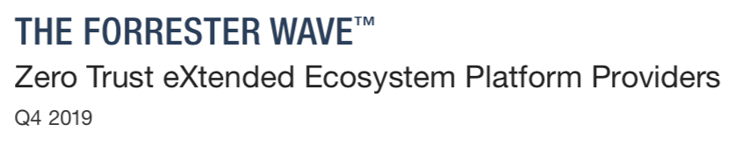

Slide 26

Cybersecurity Best Practices Focus On:
  Risk Management
  Intelligence
  Visibility
  Security Technology
  Compliance and Score Cards
The goal: secure, end to end, and communicative cybersecurity Infrastructure

Slide 27


Risk Management
How can we
efficiently
and
effectively
manage our
cyber risks?
Unacceptable Risk Level
Acceptable Risk Level

Slide 28
Intelligence
Up to date intelligence data consumed by security environment
Worldwide visibility
Behavior monitoring
Automated updates
Proactive threat hunting
See globally…
Protect locally

Slide 29
Visibility
Identify the who or what
Endpoint →data center →cloud
Spot, Stop, and Mitigate quicker
See abnormalities
  Address Encryption
  Include Context
  Watch in/out/east/west flows
  Privilege escalation monitoring
If You Don’t Know What You Have How Can You Protect it?

Slide 30
Security Technology
Identity
Threat Detection
Segmentation
Automation/
Integration
Policies enforced
Continuous authentication
Least-trust approach
Users, Devices, Apps, Data
Anytime, anywhere
Protection processes continually improved
Malware Defense
Anti-phishing
Data integrity
Users, devices, applications, data
Anytime, anywhere
Limit propagation
Micro-segmentation
Logically segmentation & control down to Layer 2
Fewer dashboards
Open Standards
Policy enforcement across infrastructure
Analytics integration
Automated response

Slide 31

Compliance and Scoring
FISMA
FITARA
NIST 800 family (53/171/37/63-3/157….)
CDM –
Continuous Diagnostics Mitigation. Phases 1, 2, 3, and 4
HVA – High Value Assets
CJIS
HSPD12-PIV
HIPAA
PCI
PII/PHI

Slide 32
How can I address these?
Zero Trust
1
2
3
4
5
Data
Securely identify
the device
Securely identify the user
Remove trust from the network
Externalise apps and workflows
Implement inventory-based access control
BeyondCorp
Devices
People
Network
Workloads
NIST Cybersecurity Framework
Visibility & analytics
Automation & orchestration
NIST SP 800-137
FIPS 199 & NIST SP 800-60
NIST Risk Management Framework
Monitor
Start
Categorize
NIST SP 800-37
6
1
FIPS 200 & NIST SP 800-53
Authorize
5
2
Select
NIST SP 800-53A
NIST SP 800-160
3
CJIS
CDM
Assess
4
Implement
CARTA

Slide 33
Need Best of Breed, Integrated Environment
With Cross-domain Analytics, Information Sharing, and Automation
Threat Intel/Enforcement
Increased Threat Prevention
Event Visibility
Decreased Time to Detect
Context Awareness
Decreased Time to Investigate
Automated Policy
Decreased Time to Remediate
Notes:
We've made sure our portfolio integrates meaningfully, by sharing key security information between products…
We share threat intelligence across the portfolio to improve threat efficacy
Event visibility is shared to decrease the time to detect threats
Sharing context across products decreases investigation times
Lastly, automating policies decreases time to remediate
…this integration delivers the automation that improves security and speeds responses.

Slide 34
Modern Security Architecture
Open APIs · Developer Environment · Services
Management · Response
Deploy
Policy
Detect
Investigate
Remediate
Technology Partners and threat feeds
Continuous Trust Verification
Users, devices, applications, and more
Enforcement Everywhere
Network
Endpoint
Cloud
Application
Comprehensive Threat Intelligence
Known Threats
Unknown/Zero-day
Notes:
[This slide is a build]
We start with best of breed products, protecting the network, endpoint, applications and cloud.
We use trust verification as a foundational piece to ensure only the right people gain access
Each product is backed with industry-leading Talos threat intelligence to block more threats to keep organizations safer.
We provide automated responses to advanced threats and streamline operations with integrated threat and security management throughout our portfolio.
Lastly we build our products to work with the other technologies you have in place for integrated security responses – even outside of Cisco.

Slide 35
Steps to a Zero Trust architectural approach
A journey with granular-enforcement based on context
Establish Trust Level
Establish SD-Perimeter
Manage Risk Level
6
5
Threat Response
4
Policy Normalization
3
2
App and Data
Access
1
Network
Access
IoT Trust
— AND/OR —
Workload Trust
Continuous Detection and Verification
Shift from macro - binary to micro - contextual
User-Device Trust
Inventory · Assess
Authorized SD-Access
Authenticate · Authorize
Micro-Segmentation
Notes:
Objective:
Agree that enforcing access everywhere is harder than ever and we must shift from macro, binary decisions to micro, contextual decisions.
Talking Points:
Inventory assets (+3rd-party) & baseline data flows
Discovery of assets and asset-to-data flows
Exchange context with partners
Normality of network traffic, workload processes, endpoint behavior, and cloud usage
Normalize behavior markers like location, risk level, vulnerabilities, and missing controls
Grant and restrict access based on dynamic context to establish trust levels and software-defined perimeters to define trust boundaries instead of static credentials and network topology.
Dynamic policy based on role and context: Guests, BYOD, Mobility, IoT, multi-cloud workloads, SSO

Slide 36
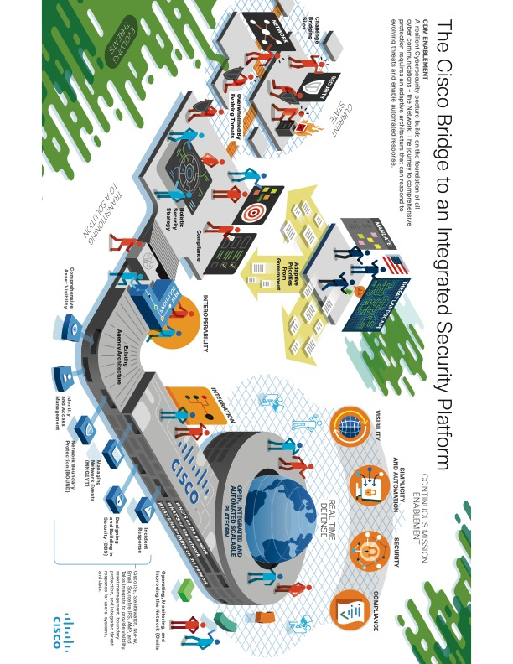
The Path to an Integrated Security Platform
A resilient Cybersecurity posture builds on the foundation of all cyber communications – the Network. The journey to comprehensive protection requires an adaptive architecture that can respond to evolving threats and enable automated response.

Slide 37


An integrated threat defense also saves money
Failover
Failover 2.0
38%+
TCO* Reduction
Replacement Box
Replacement Box 2.0
Point
Products
Approach
SIEM
SIEM 2.0
IDS
IDS 2.0
Persistent Threats
Persistent Threats 2.0
DLP
DLP 2.0
Architectural Approach
Web Security
Web Security 2.0
Email Security
Email Security 2.0
VPN
VPN 2.0
Firewall
Firewall 2.0
* Final Results
Notes:
.

Slide 38
If you have a
scalable, open and automated foundation, you can address all Approaches and Frameworks

Slide 39
From Overwhelmed to
Empowered
With an integrated approach to security
Notes:
We’ve outlined challenges in responding to threat and regulating access – but how, as defenders, can we better manage risk?
How do we become less overwhelmed and more empowered?

Slide 40
Cisco products to meet:
ZT, ZTX and CARTA
Identity Services Engine | SDA, policy enforcement, micro-segmentation, endpoint profiling & posture
AMP Everywhere | Advanced Malware Protection
StealthWatch | Traffic Analysis – Identify abnormal and known-bad traffic patterns
Tetration | Data Center Policy, Application, policy and traffic analysis
Cloudlock | Security for SAAS applications
Cisco DNA-Center | Campus Segmentation w/ SDA
APIC | Data center policy, ACI
AnyConnect | Posture, dot1x, EAP-Chaining, MACsec, Umbrella, NVM
ThreatGrid | Threat research and response – endpoint security
Encrypted Traffic Analytics | Malware detection in encrypted traffic without decryption
Duo | Application access control with multi-factor authentication (MfA)

Slide 41
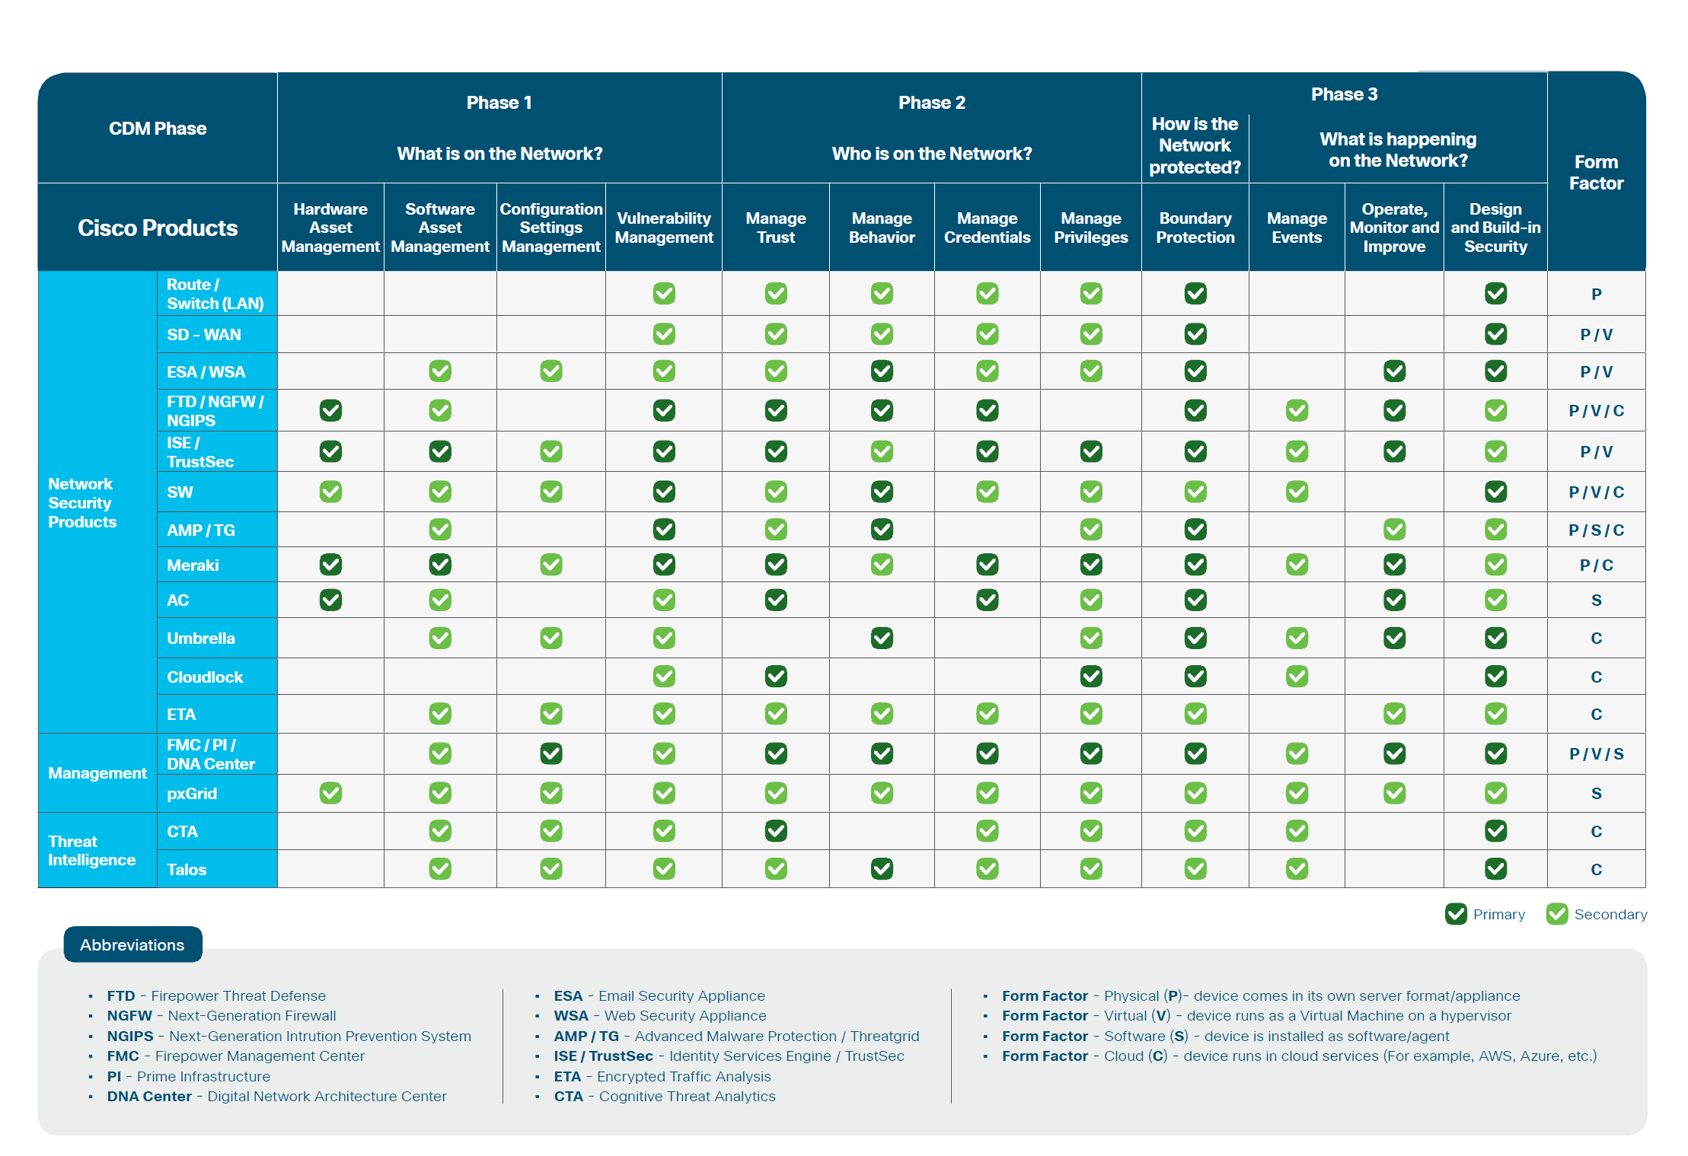
Continuous Diagnostics Mitigation (CDM)

Slide 42
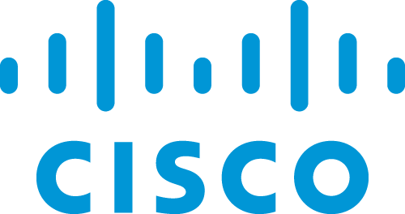
NIST CSF Alignment
Cisco Security Products
ISE & Duo
Managed
Implementation
Cognitive
Advisory
Firepower
AnyConnect
Stealthwatch
Umbrella
TrustSec
Cloudlock
AMP/Threat Grid
Web/Email
ID | Asset Management
 | Business environment | Non-technical control area
 | Governance | Non-technical control area
 | Risk Assessment
 | Risk Management | Non-technical control area
 | Supply Chain | Cisco Security and Trust Organization (S&TO)
PR | Access Control
 | Awareness Training | Non-technical control area
 | Data Security
 | Info Protection Process | Non-technical control area
 | Maintanence
 | Protective Technology
DE | Anomalies and Events
 | Continuous Monitoring
 | Detection Process | Non-technical control area
RS | Response Planning | Non-technical control area
 | Communications | Non-technical control area
 | Analysis
 | Mitigation
 | Improvements | Non-technical control area
RC | Recovery Planning | Non-technical control area
 | Improvements | Non-technical control area
 | Communications | Non-technical control area

Slide 43
NIST SP 800-53
Cisco Solution Alignment Summary by Control Family
Web/Email
Security
Cognitive Threat
Analytics (CTA)
Identity Services
Engine (ISE) & Duo
AMP/Threat Grid
Stealthwatch
CloudLock
Umbrella
ASA/Firepower
TrustSec
AnyConnect
AC
Access Control
AT
Awareness/Training
AU
Audit/Accountability
CA
Security Assessment
CM
Configuration Mgmt
CP
Contingency Planning
IA
Identification/AuthN
IR
Incident Response
MA
Maintenance
MP
Media Protection
Cisco Safety and Security
PE
Physical Environment
PL
Planning
PS
Personnel Security
RA
Risk Assessment
SA
System Acquisition
SC
Sys/Comm Protection
SI
Sys/Info Integrity
PM
Program Management

Slide 44
NIST SP 800-171
Cisco Solution Alignment Summary by Control Family
Web/Email
Security
Cognitive Threat
Analytics (CTA)
Identity Services
Engine (ISE) & Duo
AMP/Threat Grid
Stealthwatch
CloudLock
Umbrella
Firepower
TrustSec
AnyConnect
1. Access Control
2. Awareness and Training
3. Audit and Accountability
4. Configuration Management
5. Identification/Authentication
6. Incident Response
7. Maintenance
8. Media Protection
9. Personnel Security
10. Physical Protection
Cisco Safety and Security Portfolio
11. Risk Assessment
12. Security Assessment
13. System/Comm Protection
14. System/Information Integrity

Slide 45
FBI CJIS Security Policy
Cisco Solution Alignment Summary by Policy Area
Web/Email
Security
Cognitive Threat
Analytics (CTA)
Identity Services
Engine (ISE) & Duo
AMP/Threat Grid
Stealthwatch
CloudLock
Umbrella
ASA/Firepower
TrustSec
AnyConnect
PA1
Info Exchange Agreements
PA2
Security Awareness Training
PA3
Incident Response
PA4
Auditing and Accountability
PA5
Access Control
PA6
Identification/Authentication
PA7
Configuration Management
PA8
Media Protection
PA9
Physical Protection
PA10
Sys/Com Protection/Integrity
PA11
Formal Audits
PA12
Personnel Security
PA13
Mobile Devices
Notes:
CJISD-ITS-DOC-08140-5.5

Slide 46

CIS CSC
Cisco Alignment Summary by Critical Security Control (CSC)
Identity Services
Engine(ISE) & Duo
AMP/Threat Grid
Stealthwatch
CloudLock
Web/Email
Security
Cognitive Threat
Analytics (CTA)
Umbrella
ASA/Firepower
TrustSec
AnyConnect
CSC1
Hardware Inventory
CSC2
Software Inventory
CSC3
Configs/Endpoints
CSC4
Vulnerability Management
CSC5
Malware Defenses
CSC6
Application Security
CSC7
Wireless Device Control
Cisco Wireless Controllers
CSC8
Data Recovery
CSC9
Skills Assessment//Training
Non-technical Control
CSC10
Configs/Network Devices
CSC11
Port/Protocol/Service Cntrol
CSC12
Admin Privileges Control
CSC13
Boundary Defense
CSC14
Audit Log Analysis
CSC15
Least Privilege Control
CSC16
Account Monitor/Control
CSC17
Data Loss Prevention
CSC18
Incident Response/Mgmt
CSC19
Secure Network Engineering
CSC20
Pen Test / Red Team
Non-technical Control

Slide 47
Thank You

Slide 48
Fundamental Transformative Drivers are Here!
Cybersecurity threat / potential adverse impact have never been greater
Increasing threat capabilities and sophistication:
  Increased availability and number of attack surfaces and attack vectors (devices / cloud / IoT / edge)
  Availability of automated and compromised tools, vulnerabilities & knowledge
  Rapidly evolving, dynamic nature of the threat
Creates the need for:
  Real-time visibility across the entire network and support infrastructure
      And the data and applications that ride across them
  Real-time enforcement of network policies for security and performance
  Ability to dynamically change network – especially in response to anomalous behavior
  Going beyond Zero Trust Security – continuous, threat-aware visibility
Notes:
NextGen = software defined

Slide 49










The Way We Work is Evolving
Data Center
IoT / IIoT / OT / Edge
VM
VM
VM
VM
VM
VM
SD-WAN
Campus & Branch Users
Private Cloud
Users Everywhere
IaaS
SaaS / PaaS
Multi-domain World with Applications / Workloads / Data everywhere

